Slide 1
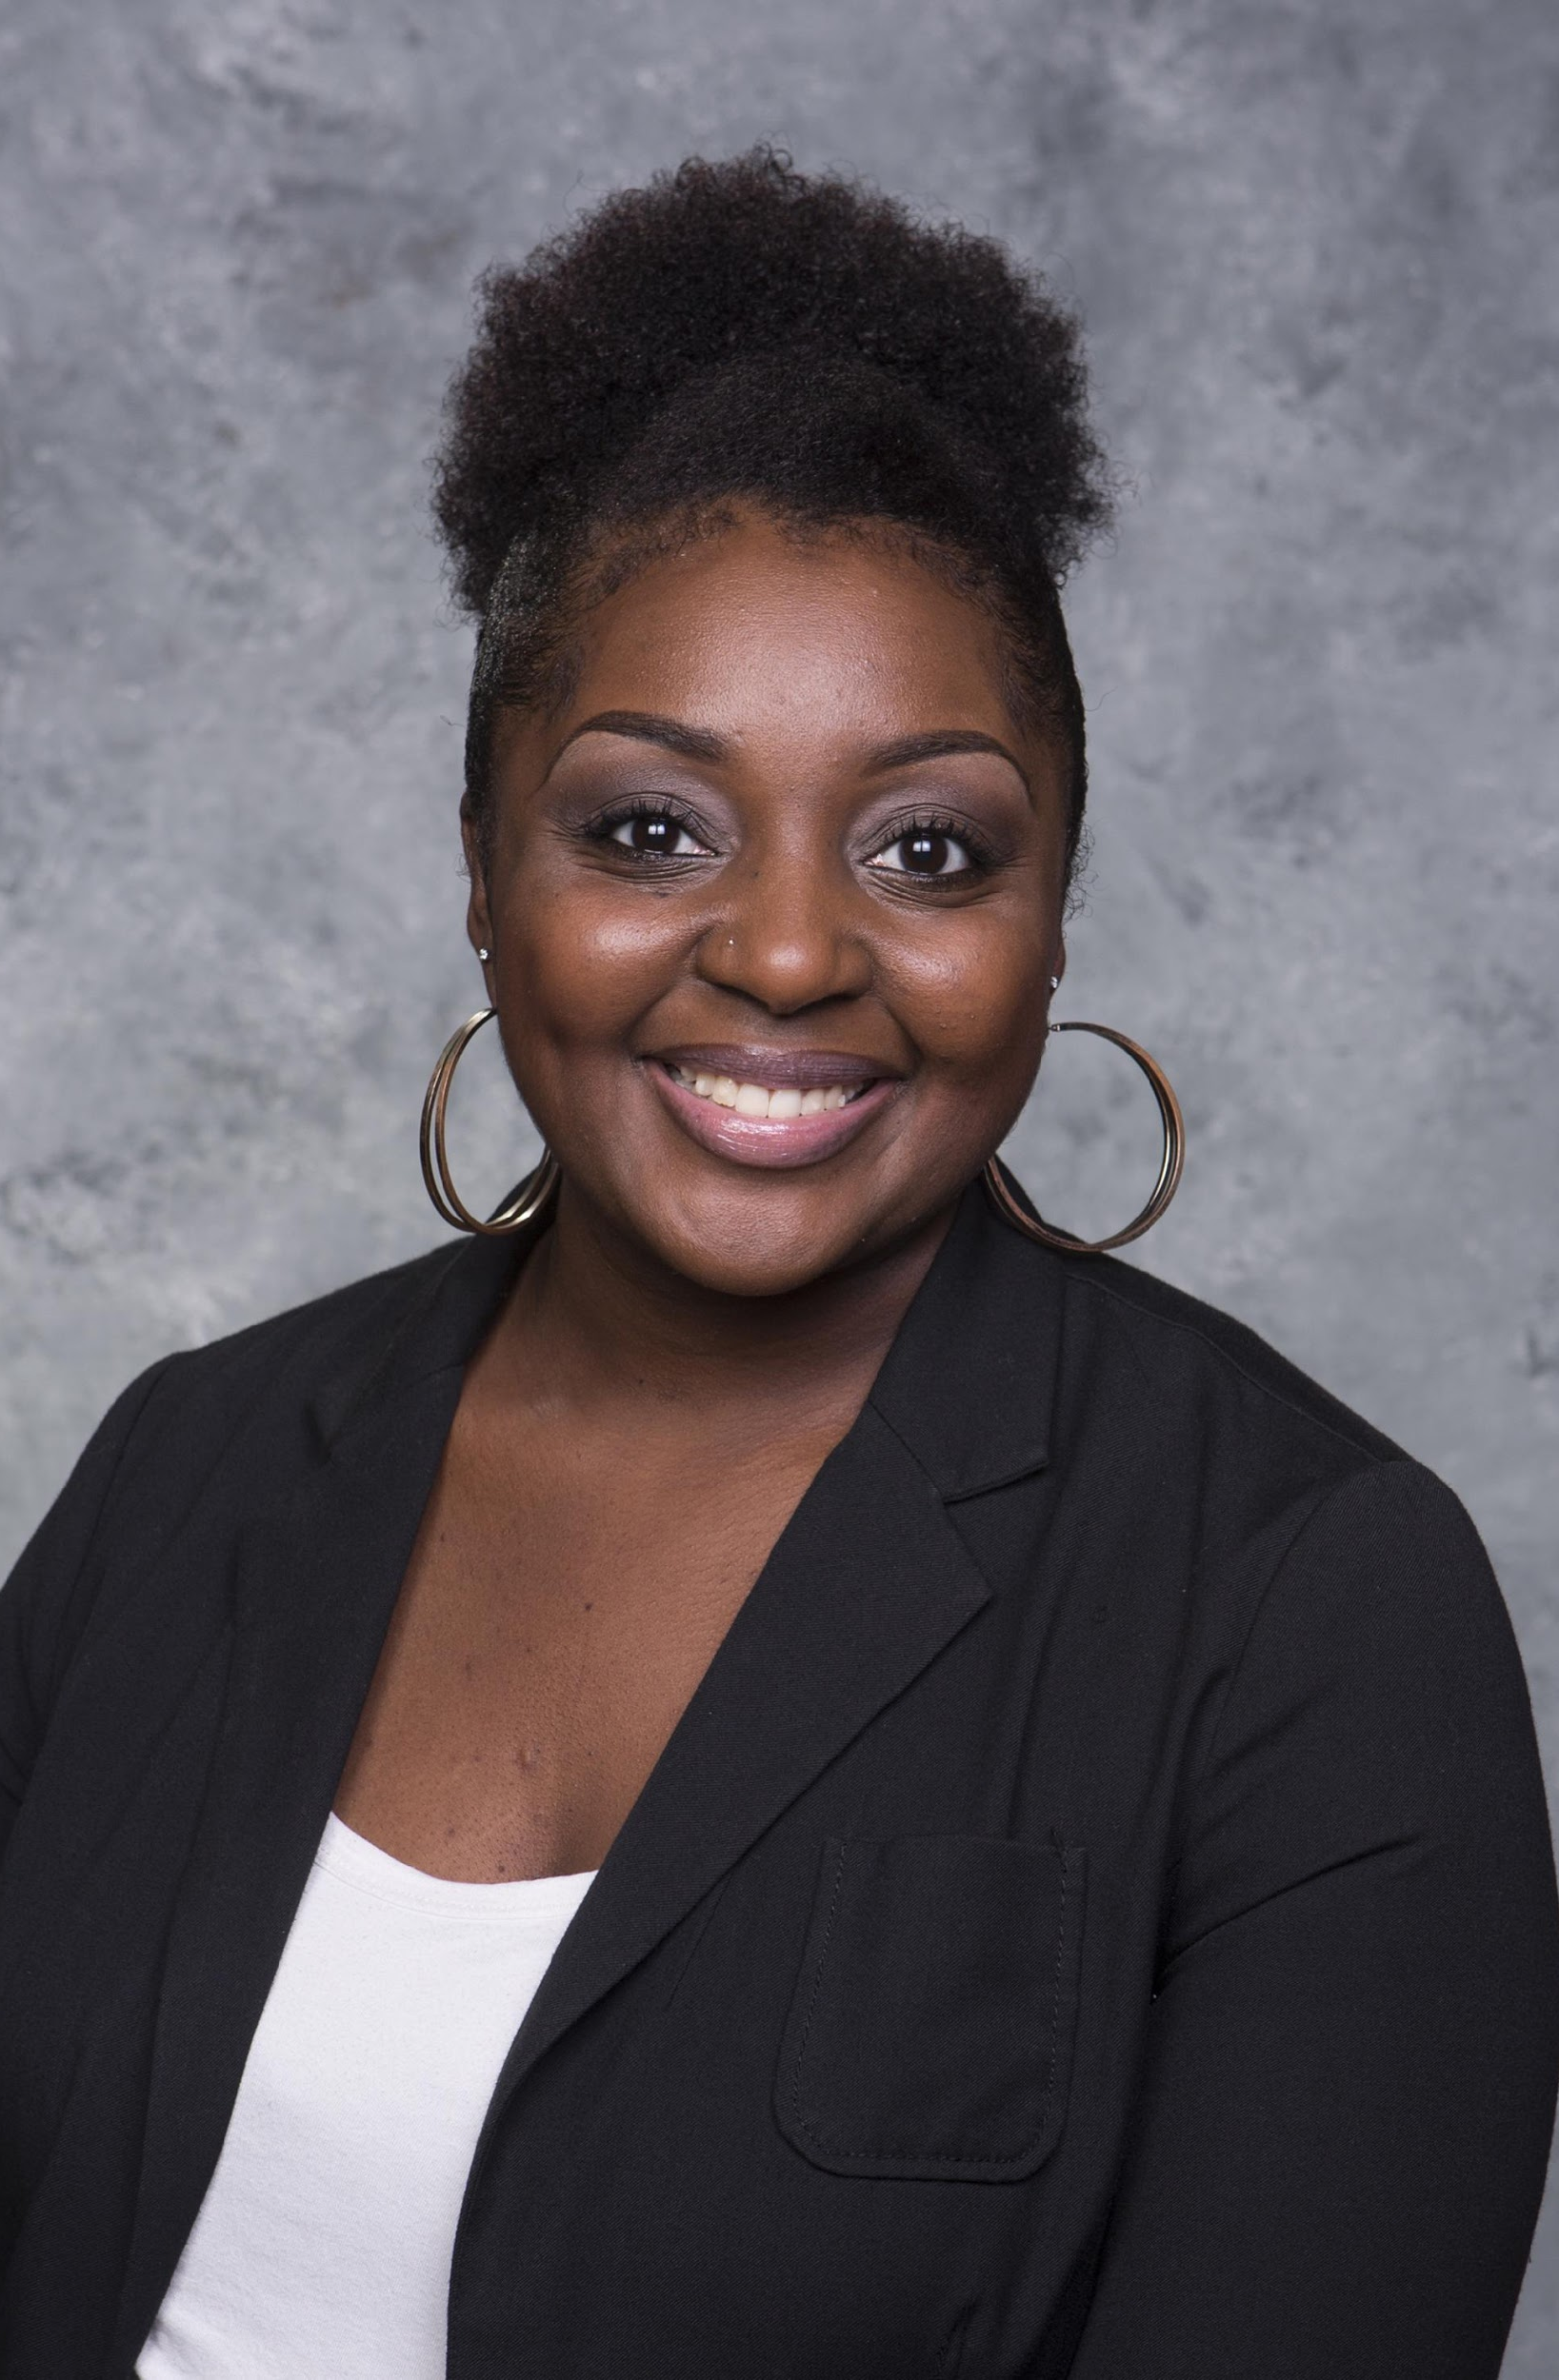
Gauging Pre-Service Teachers’ Awareness of Dialectical Code Switching in Classroom Settings
Drake Curette
2018
Undergraduate Research Exposition
Lamar University
Beaumont, TX

Slide 2
What is Code Switching?
"Code switching," "style-shifting," or "dialect-shifting" are terms used to refer to the changing of one's dialect production in response to external stylistic influences" (Craig, 2016, p. 60).

Slide 3
Purpose Statement
The purpose of this study was to
gauge pre-service teachers’ awareness of dialectical code switching in classroom settings.

Slide 4
Related Literature
African American Vernacular English (AAVE) originated when Africans from various African countries were brought together during slavery. In order to communicate, the blending of their tribal languages with English created what is known now as the Black dialect, Ebonics, or slang.
“Instead of using “right” or “wrong” to describe Standard American English versus African-American English, Dr. Craig’s model uses “formal” and “informal” designations, so there’s no judgment attached to either language.”
Moreover, in education students have lower reading test scores because of the literacy gap in grade school of not correctly being taught how to code switch, specifically as it relates to African American students (Craig, 2016).
AAE - African American English
AAVE – African American Vernacular English

Slide 5
Research Questions
What knowledge do pre-service have of dialectical code switching?
Is code switching important for teachers to understand?

Slide 6
Methodology
embedded mixed methods design.
Likert scale online survey instrument.
semi-structured, open-ended interviews.

Slide 7
Participants
Pre-service teachers in an undergraduate teacher preparation program.
Elementary, middle, and high school prospective teachers.
Recruited voluntarily.
Student teachers included, no certified classroom teachers.
Study included interns and students that have taken ELA and SS coursework, final classes.

Slide 8
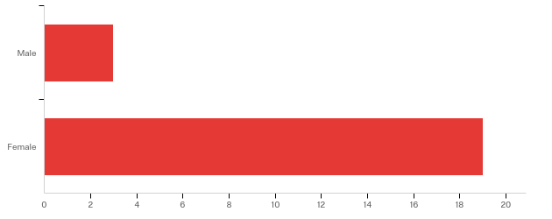
Gender Data
Answer | % | Count
Male | 13.64% | 3
Female | 86.36% | 19
Total | 100% | 22

Slide 9
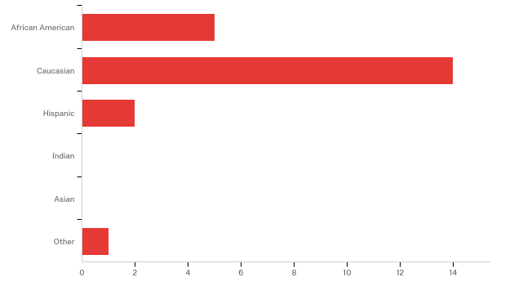
Demographic Data
Answer | % | Count
African American | 22.73% | 5
Caucasian | 63.64% | 14
Hispanic | 9.09% | 2
Indian | 0.00% | 0
Asian | 0.00% | 0
Other | 4.55% | 1
Total | 100% | 22

Slide 10
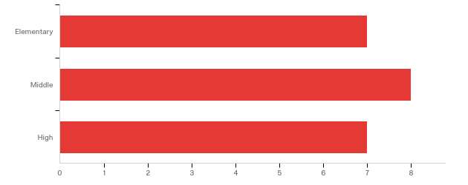
Pre-Service Teachers’ Classification
Answer | % | Count
Elementary | 31.82% | 7
Middle | 36.36% | 8
High | 31.82% | 7
Total | 100% | 22

Slide 11
Findings for Research Question 1
What knowledge do pre-service teachers have of dialectical code switching?

Slide 12
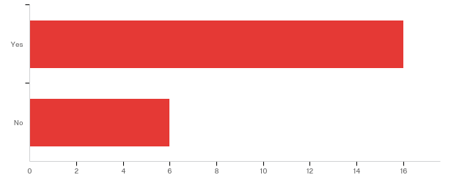
Findings for Research Question 1
What knowledge do pre-service have of dialectical code switching?
Answer | % | Count
Yes | 72.73% | 16
No | 27.27% | 6
Total | 100% | 22

Slide 13
Findings for Research Question 1
What knowledge do pre-service have of dialectical code switching?
Item | Not Aware | # | Somewhat Aware | # | Very Aware | # | Total
There are books and activities that acknowledge different dialects, such as in African American Vernacular English (AAVE) | 40.91% | 9 | 45.45% | 10 | 13.64% | 3 | 22
Students have the ability to learn to code switch | 13.64% | 3 | 40.91% | 9 | 45.45% | 10 | 22
Research is available about strategies to enhance code switching in the classroom | 40.91% | 9 | 45.45% | 10 | 13.64% | 3 | 22
Linguistic code switching is different among cultures | 13.64% | 3 | 50.00% | 11 | 36.36% | 8 | 22
There are a variety of programs similar to Toggle Talk that are a vocabulary and language structure awareness systems for switching from informal language (home) to formal language (standard/school) | 77.27% | 17 | 22.73% | 5 | 0.00% | 0 | 22

Slide 14
Findings for Research Question 1
What knowledge do pre-service have of dialectical code switching?
Item | Not Aware | # | Somewhat Aware | # | Very Aware | # | Total
You can teach children how to make situationally appropriate language choices | 4.55% | 1 | 40.91% | 9 | 54.55% | 12 | 22
A mismatch may exist between academic (Standard American English) and non-academic language, such as AAVE | 22.73% | 5 | 27.27% | 6 | 50.00% | 11 | 22
Students who are able to code switch in early elementary may experience academic gains in the area of literacy | 27.27% | 6 | 45.45% | 10 | 27.27% | 6 | 22
Students who learn to "code-switch" early show more academic gains by the end of elementary school than those who take longer to do so. | 40.91% | 9 | 40.91% | 9 | 18.18% | 4 | 22
Students may be unaware that there is a difference between their own dialect and that of Standard American English | 4.55% | 1 | 31.82% | 7 | 63.64% | 14 | 22

Slide 15
Findings for Research Question 1 What knowledge do pre-service have of dialectical code switching?
"I have never heard of it, and I am almost done with my degree….”
“It is important for pre-service teachers to be aware of different cultures. It is important to understand where they come from and connect with [those students for] a safe environment."
"I would say that prospective teachers should be aware of code switching. When working with students, cultural backgrounds [are brought] to standardized testing, assessments, meetings with parent in understanding and respecting their cultural influences/backgrounds. I do code switching. I've lived in the South and the North. We all have examples of code switching. When we dive into our own special vernaculars. We speak in our own dialectical background when speaking."

Slide 16
Discussion for Research Question 1 What knowledge do pre-service teachers have of dialectical code switching?
Some participants that will be graduating soon did not know much about code switching, were not around other cultures to see various backgrounds, however were interested and wished they were introduced to code switching in their academic careers.
Study participants who had Hispanic and African American background were able to elaborate because they experienced the challenge of dialect switching in the classroom.
Study participants also agreed that incorporating culturally competent lessons in curriculums will keep students engaged.

Slide 17
Findings for Research Question 2
Is code switching important for teachers to understand?

Slide 18
Findings for Research Question 2 Is code switching important for teachers to understand?
"Yes, teachers are too busy focused on the curriculum and academics than the social aspect of helping the students grow in the class setting."
"Yes, it is important for pre-service to be aware of different cultures. It is important to understand where [students] are coming from ….to have a safe environment."
“Yes, I believe many teachers are set in their ways and want [students] to listen to what they have to say.”
"Yes, they should because that way they can, if they are aware of it, try to understand where the students are coming from. They can communicate better if they understand where they are coming from."

Slide 19
Discussion for Research Question 2 Is code switching important for teachers to understand?
Pre-service teachers acknowledged that nurturing a relationship with students, understanding their cultural backgrounds, and taking time out to teach in a variety of ways will help students feel safe and empowered.
AAE speaking students may not grasp lessons at the same pace as other students.
Pre-service teachers expressed, knowing diverse cultures is necessary in order to connect and understand their student's needs.
Connecting with students through their cultural makes them feel safe in the classroom, and this allows them to be open because the child will know that their teacher understands them. Helping students build strategies for code switching in classroom settings is vital to the future success of learners of varying backgrounds.

Slide 20
Recommendations for Future Research
Replicate this study with different groups of pre-service teachers in different courses during their teacher preparation program.
Partner with other institutions to replicate the study with pre-service teachers.
Interview current educators to gauge their awareness of dialectical code switching in classroom settings.
Interview current students of all age groups to gauge their ability to ”on demand” code switch into SAE.

Slide 21
Conclusions
When interviewing pre-service teachers, they had limited knowledge of ‘code-switching’ or how to work with students that speak an alternate dialect in their home settings.
Pre-service teachers were not overly aware of resources that would assist students in an educational setting who speak (AAVE).
Despite much controversy on whether to implement lessons that will enhance code switching in learning, it remains a tough sell. The state Superintendent from the Oakland school district commented, "We are not aware of any research which indicates any program will help address the language achievement problems of African American students" (Woo & Moore, 1996).

Slide 22
Conclusions
It is possible to bridge the language gap if students are given time to process and learn to code switch using effective strategies and resources.
Strategies for code switching need to be shared in classrooms today so educators have access and know how to locate the materials.

Slide 23
References
Craig, H. (2016). African American English and the achievement gap. New York, NY: Routledge.
Guerra, J. (2014, July). Interview: Teaching students how to switch between Black English and Standard English can help them get ahead. Retrieved from http://stateofopportunity.michiganradio.org/post/teaching-students-how-switch-between-black-english-and-standard-english-can-help-them-get-ahead
Woo, E. & Moore, S. (1996, December). School decision on black English stirs up a storm of commentary. Los Angeles Times. Retrieved from http://articles.latimes.com/1996-12-21/news/mn-11386_1_black-english

Slide 24
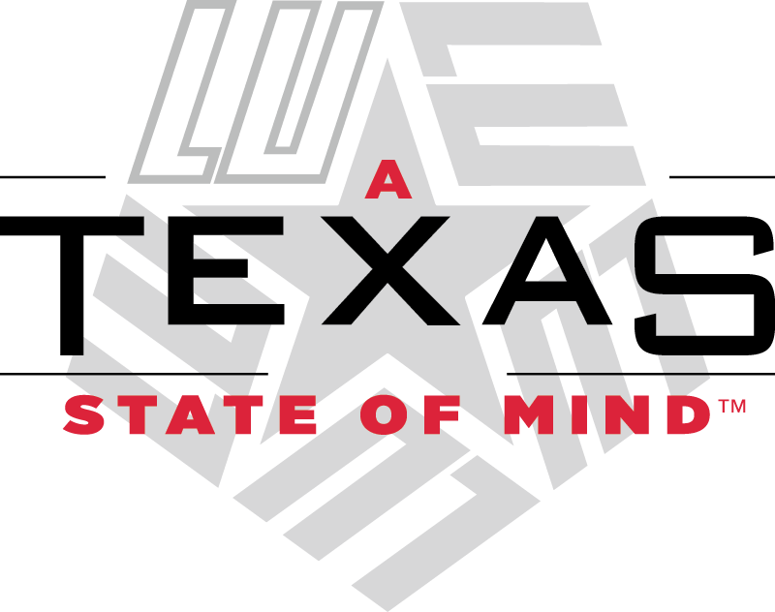
Contact Information
Drake Curette
Senior Undergraduate Student Researcher
Department of English & Modern Languages
Lamar University
Beaumont, TX
dcurette@lamar.edu
832.556.9571
Tilisa Thibodeaux, Ed. D. (Mentor)
Assistant Professor
Digital Learning and Leading
Department of Educational Leadership
Lamar University
Beaumont, TX
tilisa.thibodeaux@lamar.edu
409.920.3487
www.tilisathibodeaux.com

