Slide 2
The Texas Academy is an accelerated program for gifted and talented high school students who attend as 11th and 12th graders on a specific track related to their intended majors.
Graduate college and start your career or degree EARLY!
Unenroll from their current high school
Eligible to be considered for top 10% auto admissions, graduate distinguished
Scholarship for 60 hours + fees covered by LU
Core complete - transferrable to any public Texas institution
Participate in innovative research
Pathway to LU’s prestigious Honors College
Learn how to read a college degree plan
Communicate with professors – transition to college
Grant funded research/scholarly productions
Access to 150 student organizations such as AMSA, etc.
Students at Texas Academy are expected to maintain a commitment to academic excellence, moral, and ethical integrity.

Slide 3
Completed application (essay, DAP, official transcripts)
Top 10-20% of 10th grade class - APPLY
Teacher / Counselor Recommendations
College ready SAT 480 RW + 530 Math OR ACT 40 ER + 22 Math
Algebra II completed

Slide 4
TA Honor Society
StuCo + 9 Clubs
TAke the Lead
VEX Robotics
150+ orgs
Peer Mentors

Slide 5
 | National | Texas | TA Class of 23' | TA Class of 24'
SAT | 1050 | 1001 | 1222 | 1225.8
ACT | 19.8 | 19.8 | 24.6 | 24.8
Class of 24’ has received $5,000,000 in scholarships and 95 colleges acceptances!

Slide 6
www.lamar.edu/texasacademy

Slide 7
We inspire students to transform their passion into their purpose through rigorous academics, innovative research, and service leadership.
Notes:
Tilisa

Slide 8
Why the Honors College?
-no cost to you
-elite top 2% on campus
-McMaster Scholarships
-Study Abroad and Study Away $ support
-Seminars, Topics, supports your degree
-community of learners like you
Honors Admissions
Completed application (essay)
3.85 GPA or top 10% of graduating class
SAT 1260 or ACT 27
letter of interest
Academic Pathways by Major
Notes:
Tilisa / Imelda
Maintain a 3.5 GPA (unless arrived prior to Fall 2023, then 3.4 GPA) and
Complete minimum 26 credit hours of honors courses, of which at least eight hours must be:
Upper-level honors courses
Include at least two Honors Seminars or one Honors Topics course
Optional: Up to three hours of research may be eligible as part of your eight hours of upper-level honors courses (cannot count as your HIEP if you choose this option).
Participate in:
At least 40 Honors Experiences over four years, with all experiences reported on your ePortfolio and
At least one High Impact Educational Practice (HIEP)

Slide 9
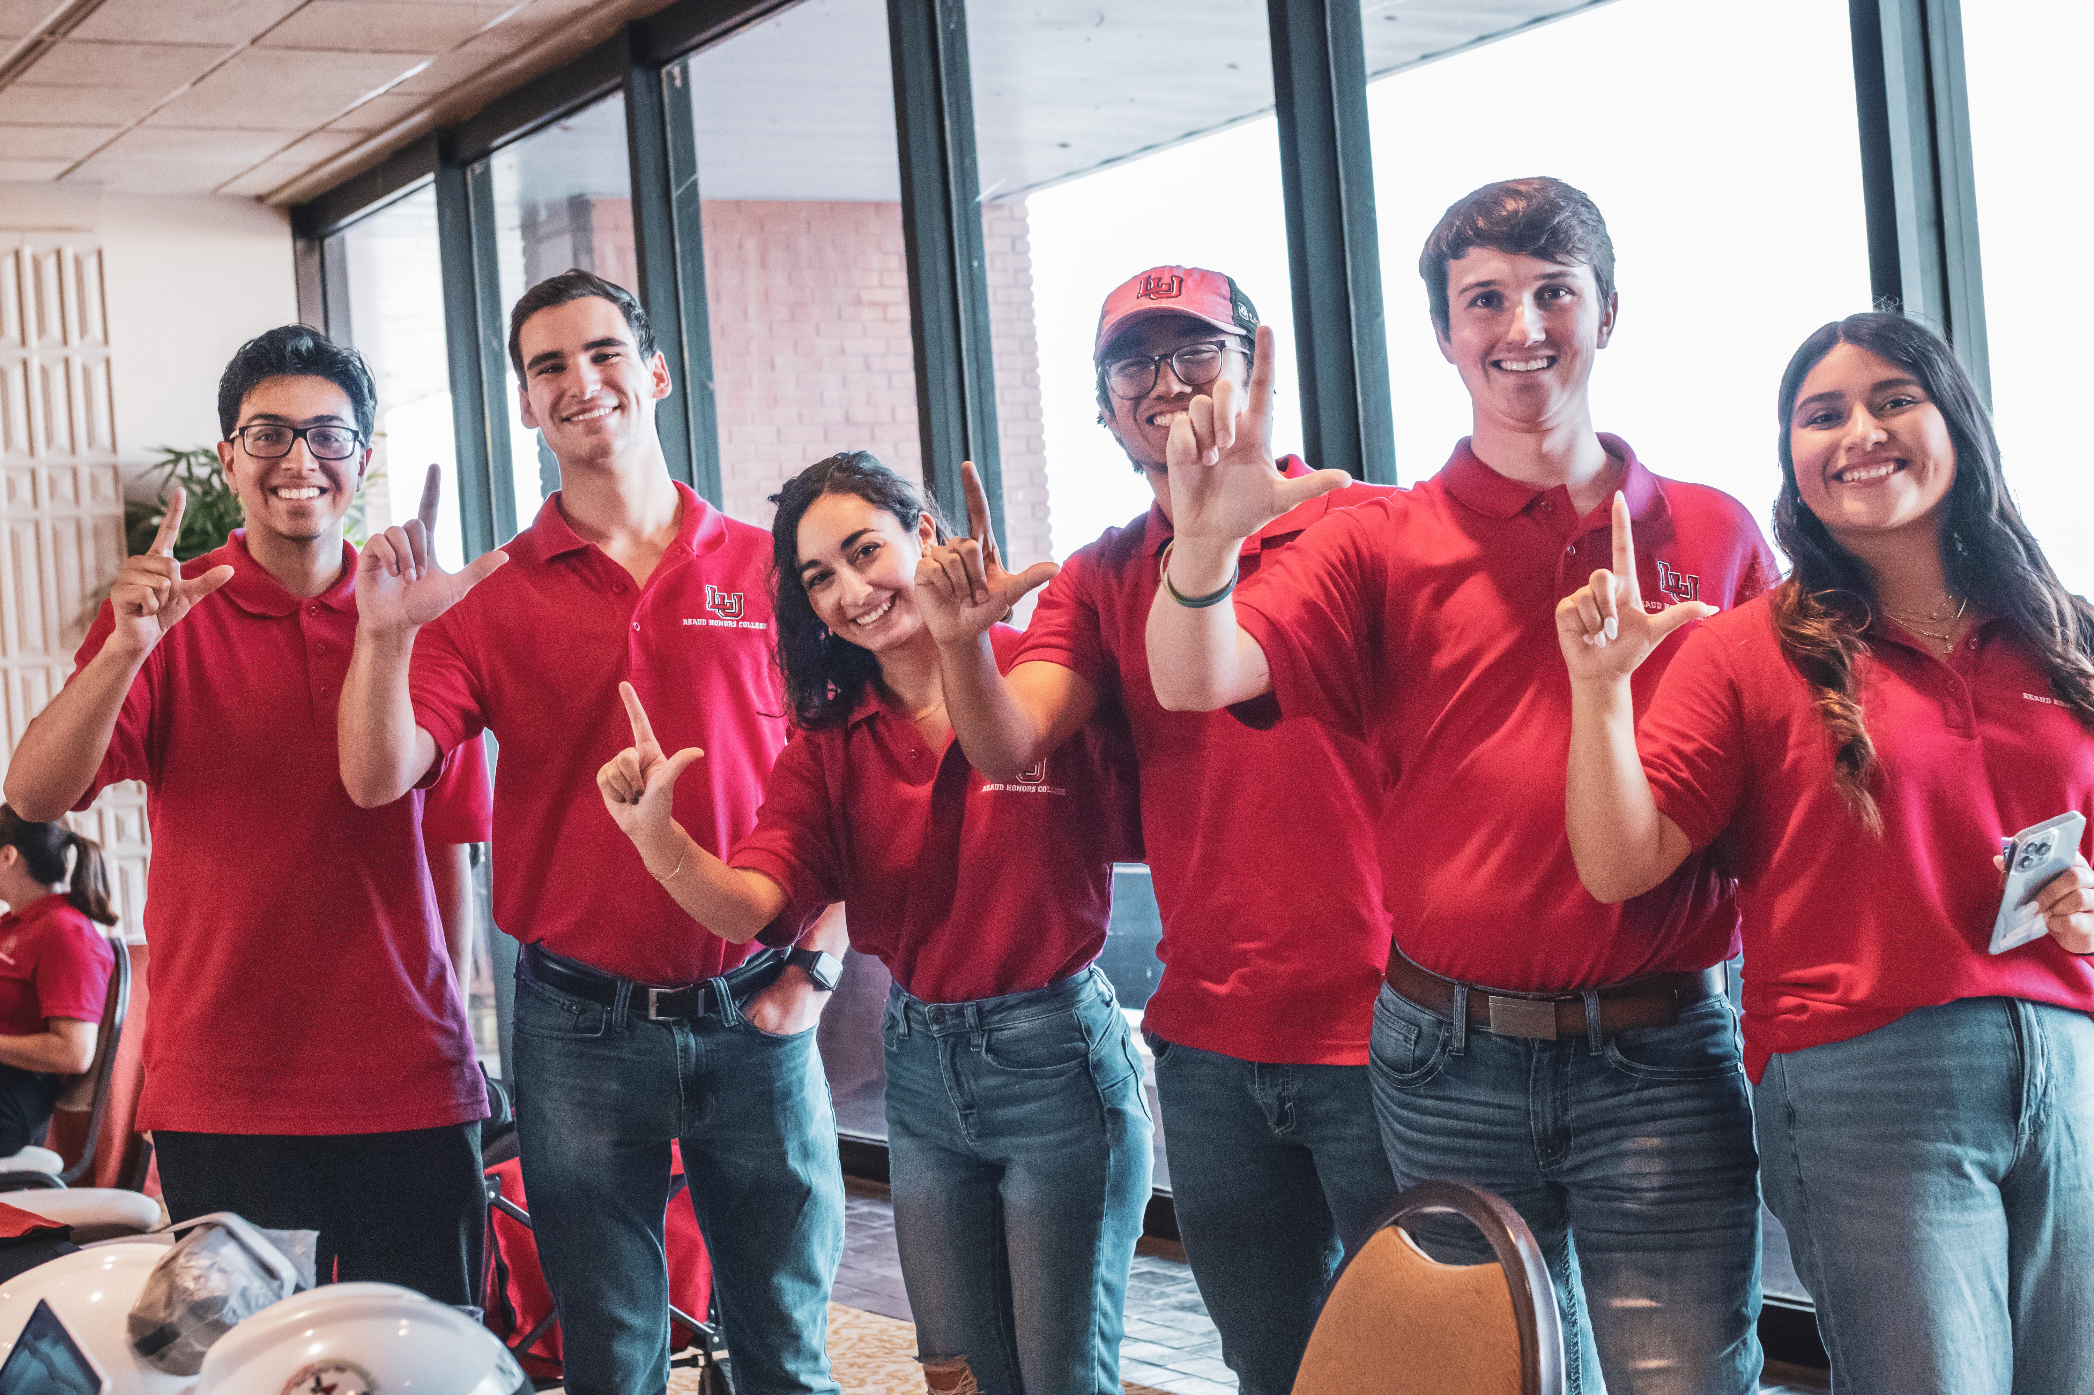
Honors and Academy Students Research and Publish
Undergraduate Research Grants Funded
Peer-Reviewed Publications
Faculty Mentors
Local and Regional Conferences
Notes:
Tony

Slide 10
53 Honors & TA students involved in undergraduate research in 2023; almost all present at local, regional, and national conferences.
TSUS Regent Student Scholar 2023
Notes:
Tony

Slide 11
Partners in the Park
Model United Nations
Bikes and Bibles
VEX Robotics
Stepping Up Civic Leadership
Study Abroad
40 Honors Experiences are logged on ePortfolio, along with classwork
https://smbark2004.wixsite.com/sergiomendez/s-projects-side-by-side
Notes:
Tilisa

Slide 12
Minor in Honors Studies
National Model United Nations
Leadership Workshops / TBT
Stepping Up Civic Leadership
Reaud Fellows / Scholars
Recognition Dinners / Stoles
Scholars Development Seminar
Notes:
Tilisa

Slide 13
www.lamar.edu/honors

