Slide 1
Learner’s Mindset - the belief that people are born with an intrinsic capacity to learn and an inquisitive nature that leads to viewing all interactions in the world as learning opportunities.

Slide 2
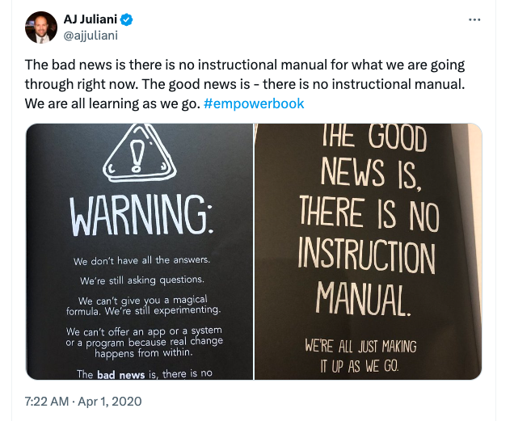

Slide 3
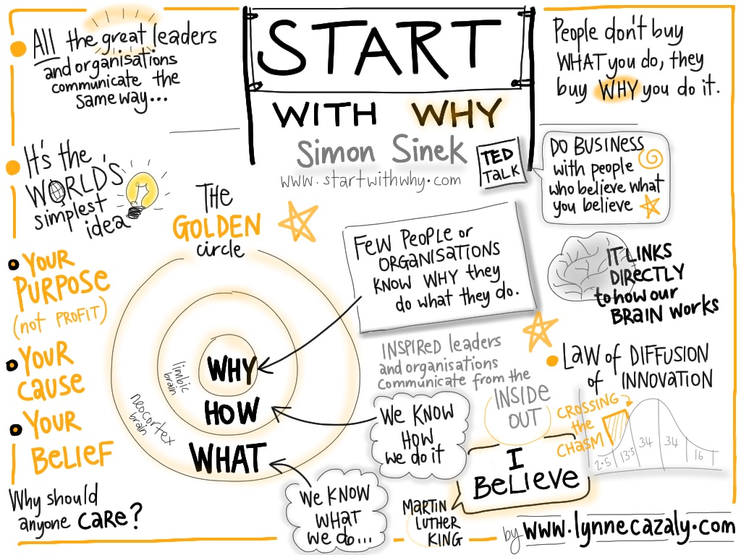

Slide 4
Journey to 100 miles (book excerpt)
My thinking (which I like to call the fixed mindset) clearly lacked intrinsic motivation and was focused on simply the task of running and what it took from me and as opposed to what it could do FOR me. You see, I was focused on the challenge and not the opportunity here. I was laser-focused on all the wrong things...
‘Learn to love what I hated’ and ‘Learn to do what I couldn’t.
I learned that I had control over every boundary and limitation I set for myself and that I was the only one putting up those begrudging stone-solid concrete walls around me.
Notes:
A runner’s story

Slide 5
Journey to 100 miles (book excerpt)
Every step of the way I hid from failure, did some things I was not always proud of, worked hard for recognition or achievement, and made myself believe somehow that I could beat failure. And to make it worse, somewhere along the line, I believed I should never fail, and I feared failure more than anything in the world. At the time, I didn’t see failure as an option and believed there to be power in the quote:
“What would you attempt to do if you knew you could not fail?” -Robert H. Schuller (1973)
Looking back, I ran from failure like the plague. I thought that if I failed and showed everyone that I was incompetent or less than worthy, or was not the quickest, brightest, best one in the room, that I was none other than a failed attempt. However, thinking back to my high school track days and my earlier days as an educator, I realized that I never, ever was able to exclude failure in my life. It happened all the time and everywhere (ironic that you could say the same thing about learning, right?) but I was unable to see it or realize its inherent built-in benefits. I ran from the very thing that I would learn could help me get the most out of life. For this reason and others, I did what Maxwell (2008) insists.... get a new definition of failure! I really needed to read this because in my mind anything less than perfect would mean I failed. I knew this thinking would hinder me in the long run, so I had to think about the best pathway moving forward. So, what became of my definition of failure? But allow me a chance to say this: internalizing failure has been a long, gradual process, so to provide meaning and context to this, I will now shift gears to the last 5 years of my career. I will share how a learner’s mindset and learning more about myself than I could ever imagine has taken shape through one failure after another. See, I grew into the notion of what failure could do FOR me instead of what it took from me. I focused on the challenge (what running took from me) instead of the opportunity (what running could do for me). Now, I need to tell another story to explain just how that happened.
Notes:
A runner’s story

Slide 6
Notes:
My journey as an assistant professor – Teaching, Research, Service

Slide 7
Research & Scholarship
Grants and Creative Projects
(Total Funded: $1,648,831)
(Total PI: 9; Total Co-PI: 6)
PI: “Governor’s Summer Merit Program: Innovation Collaboration,” $99,925 funded by the Texas Workforce Commission (TWC), March 2024-August 2024.
Co-PI: “Assessing the Awareness, Knowledge, and Understanding of Flossing Among Pre-Dental Students and Pre-Service Teachers,” $1,100 funded by the Office of Undergraduate Research, Lamar University, October 2021-August 2023.
PI: “Governor’s Summer Merit Program: Innovation Collaboration,” $99,997 funded by the Texas Workforce Commission (TWC), March 2024-August 31, 2023.
PI: “Ronald E. McNair Postbaccalaureate Achievement Program Proposal: From Low-Income and Underrepresented Students to Next-Generation Leaders,” $1,300,000 ($259,198 over 5 years) funded by the U.S. Department of Education, October 2022-August 2027.
Peer-Reviewed Publications (First Author: 10; Second Author: 2; Other: 4) (17 Creative Activities, 2 ebooks)
Thibodeaux, T. N., Kemerly, T. S., & Craig, T. B. (2024). Students’ perceptions of STEM camp experience that impacts career pathways: A Mixed Methods Study. Manuscript in progress.
Thibodeaux, T. N., & Harapnuik, D. K. (2023). Graduate students’ perceptions of feedback for learning in an online program. Manuscript submitted for publication.
(3) Wilson, K., Washington, K., Brown, K,
Bellard, Q., & Thibodeaux, T. (2022).
Parent perspectives of digital learning
experiences: A phenomenological study. School
Leadership Review 17(1), 1-53.
https://scholarworks.sfasu.edu/slr/vol17/iss1/6
Thibodeaux, T. N., & Harapnuik, D. K. (2020). Exploring students’ use of feedback to take ownership and deepen learning. International Journal of e-Learning 19(1), 79-88. https://www.learntechlib.org/primary/j/IJEL
Notes:
1 article in review, 1 article almost finished, 1 article with a submitted IRB or in progress = 4 active studies
68 Conference Papers, Presentations, Workshops, Retreats, Keynotes
7 Programs, 14 graduate courses, 4 undergraduate courses, 6 dissertation chair, 19 dissertation committees, 3 undergraduate research projects, over 100 service projects

Slide 8
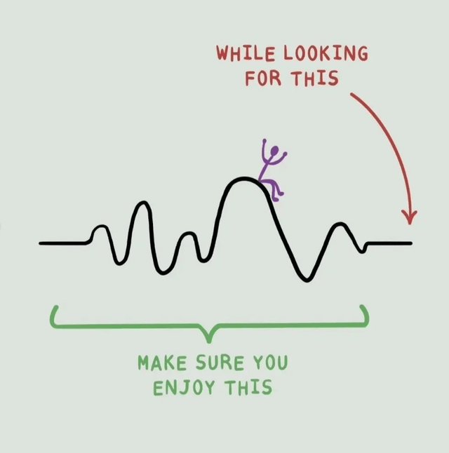
Onwards and upwards, but never straight ahead.

Slide 9
“The learner’s mindset encompasses so many things: failing forward, finding new opportunities within challenges, exploring your imagination, constructing and experimenting with new ideas, and understands that most difficult things do not come easy, but they are worth the effort.”

Slide 10
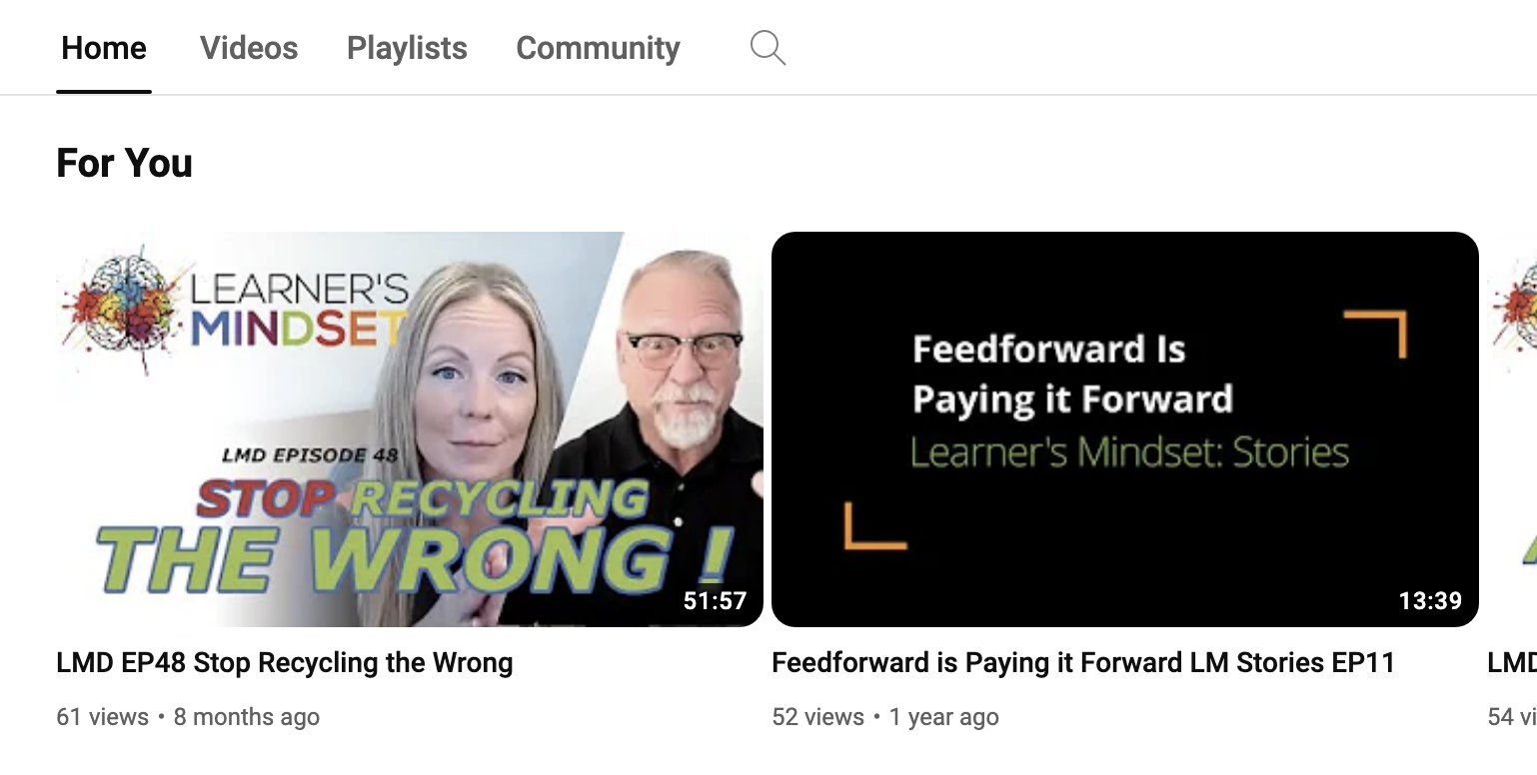
Notes:
Relinquish some control and allow for imagination, creativity, experimentation in learning experiences.
Focus on who you want to become and not what the has decided for you.

Slide 11
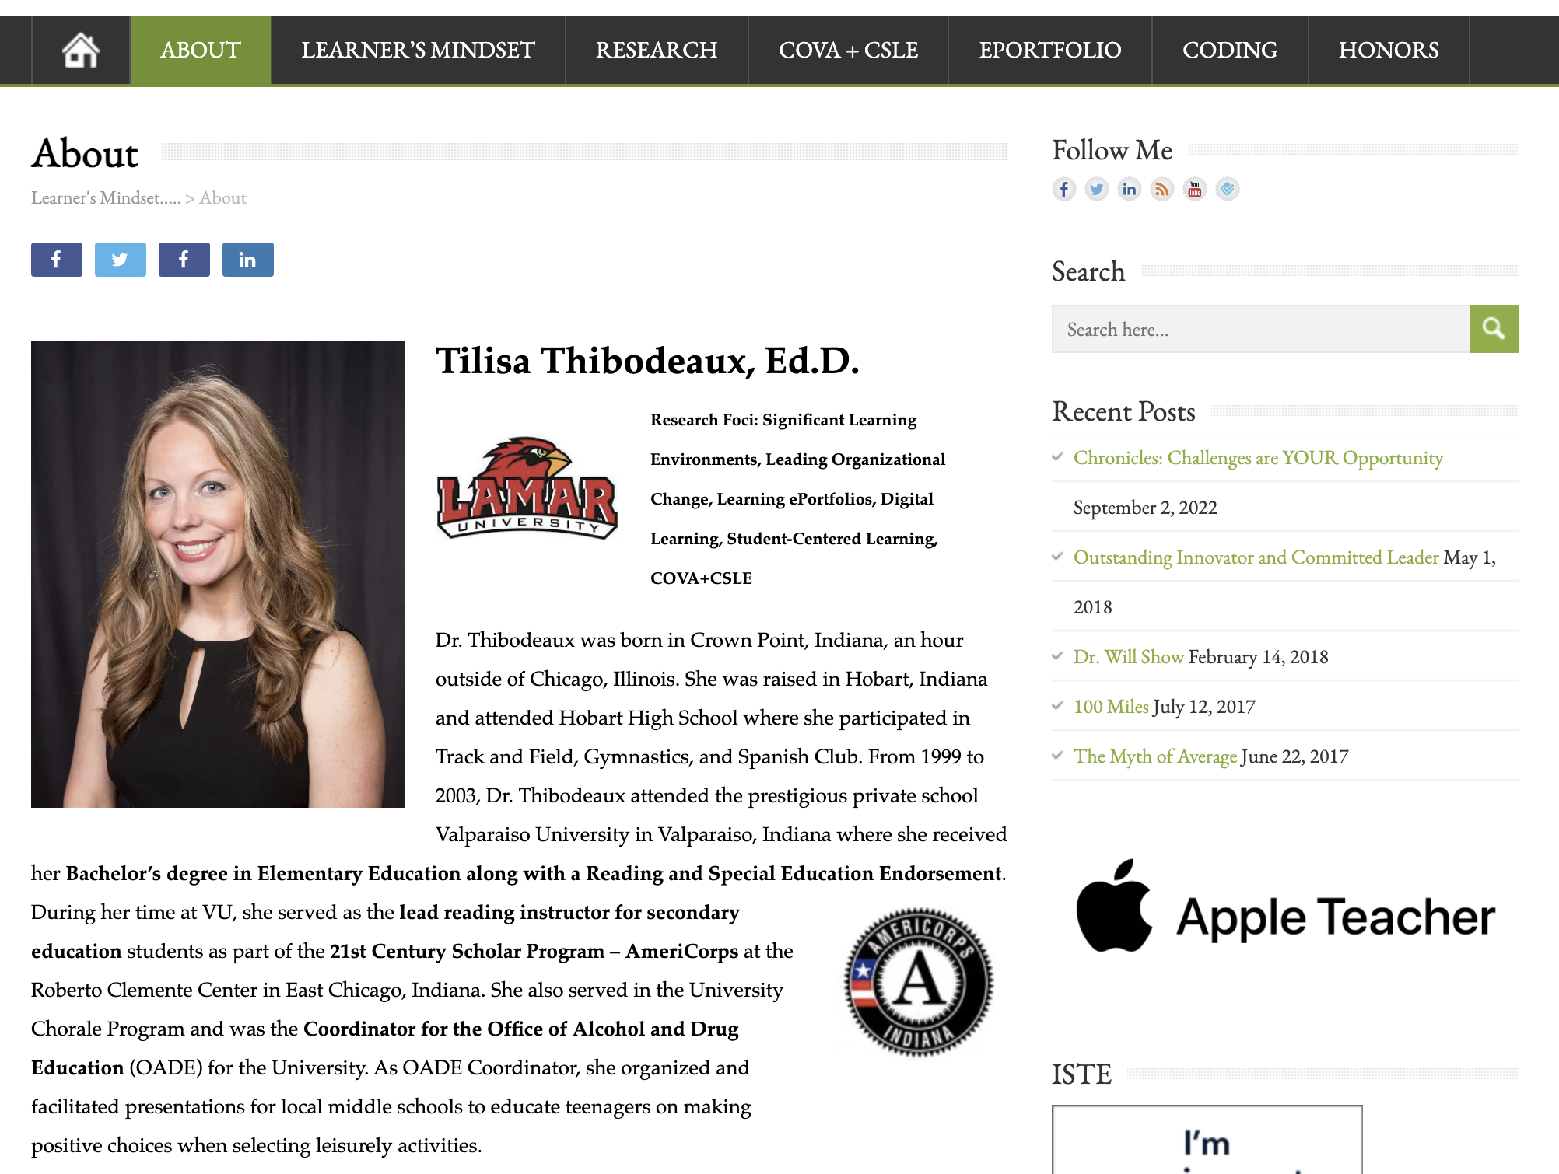

Slide 12
Inspirational Quotes
“Whether you believe you can do a thing or not, you are right.” -H. Ford, personal communication, September (1947)
“No. Try not. Do... or do not. There is no try.” -Yoda (Kershner, 1980)
An ordinary man sees problems as challenges or barriers; an extraordinary man sees problems as opportunities.
-eMyth Revisited, Michael Gerber (2001)
“Everything you have ever wanted is sitting on the other side of fear.” -George Addair (2018)
“Failure is the engine for innovation.” Diamandis & Kotler (2012)
“If failure is something you run from, I advise you to run into it rather than away from it.” -Tilisa Thibodeaux (2022)

Slide 13
References
Addair, G. (2018, September 4). Everything You’ve Ever Wanted is Sitting on the Other Side of Fear. Forbes. https://www.forbes.com/sites/amyblaschka/2018/09/04/everything- youve-ever-wanted-is-sitting-on-the-other-side-of-fear/#7d2f2f703979
Diamandis. P. & Kotler, S. (2012). Abundance: The future is better than you think. Free Press.
Gerber, M. E. (2001). E-myth revisited: Why most small businesses don’t work and what to do about it. HarperCollins.
Goldsmith, M. (2015, October). Try feedforward instead of feedback. Marshall Goldsmith.https://www.marshallgoldsmith.com/
Harapnuik, D. K. (2023). Learner’s mindset. https://www.harapnuik.org/?p=8705
Kershner, I. (Director). (1980). Star Wars: Episode V-The Empire Strikes Back [Film]. Lucasfilm.
Sinek, S. (2010, May). How great leaders inspire action [Video]. TED Conferences. https://www.ted.com/speakers/simon_sinek

