Slide 1
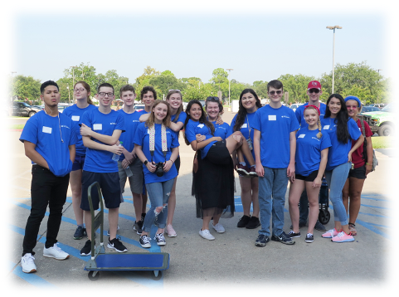

Robotic Cardinals Day
Notes:
Tilisa

Slide 2
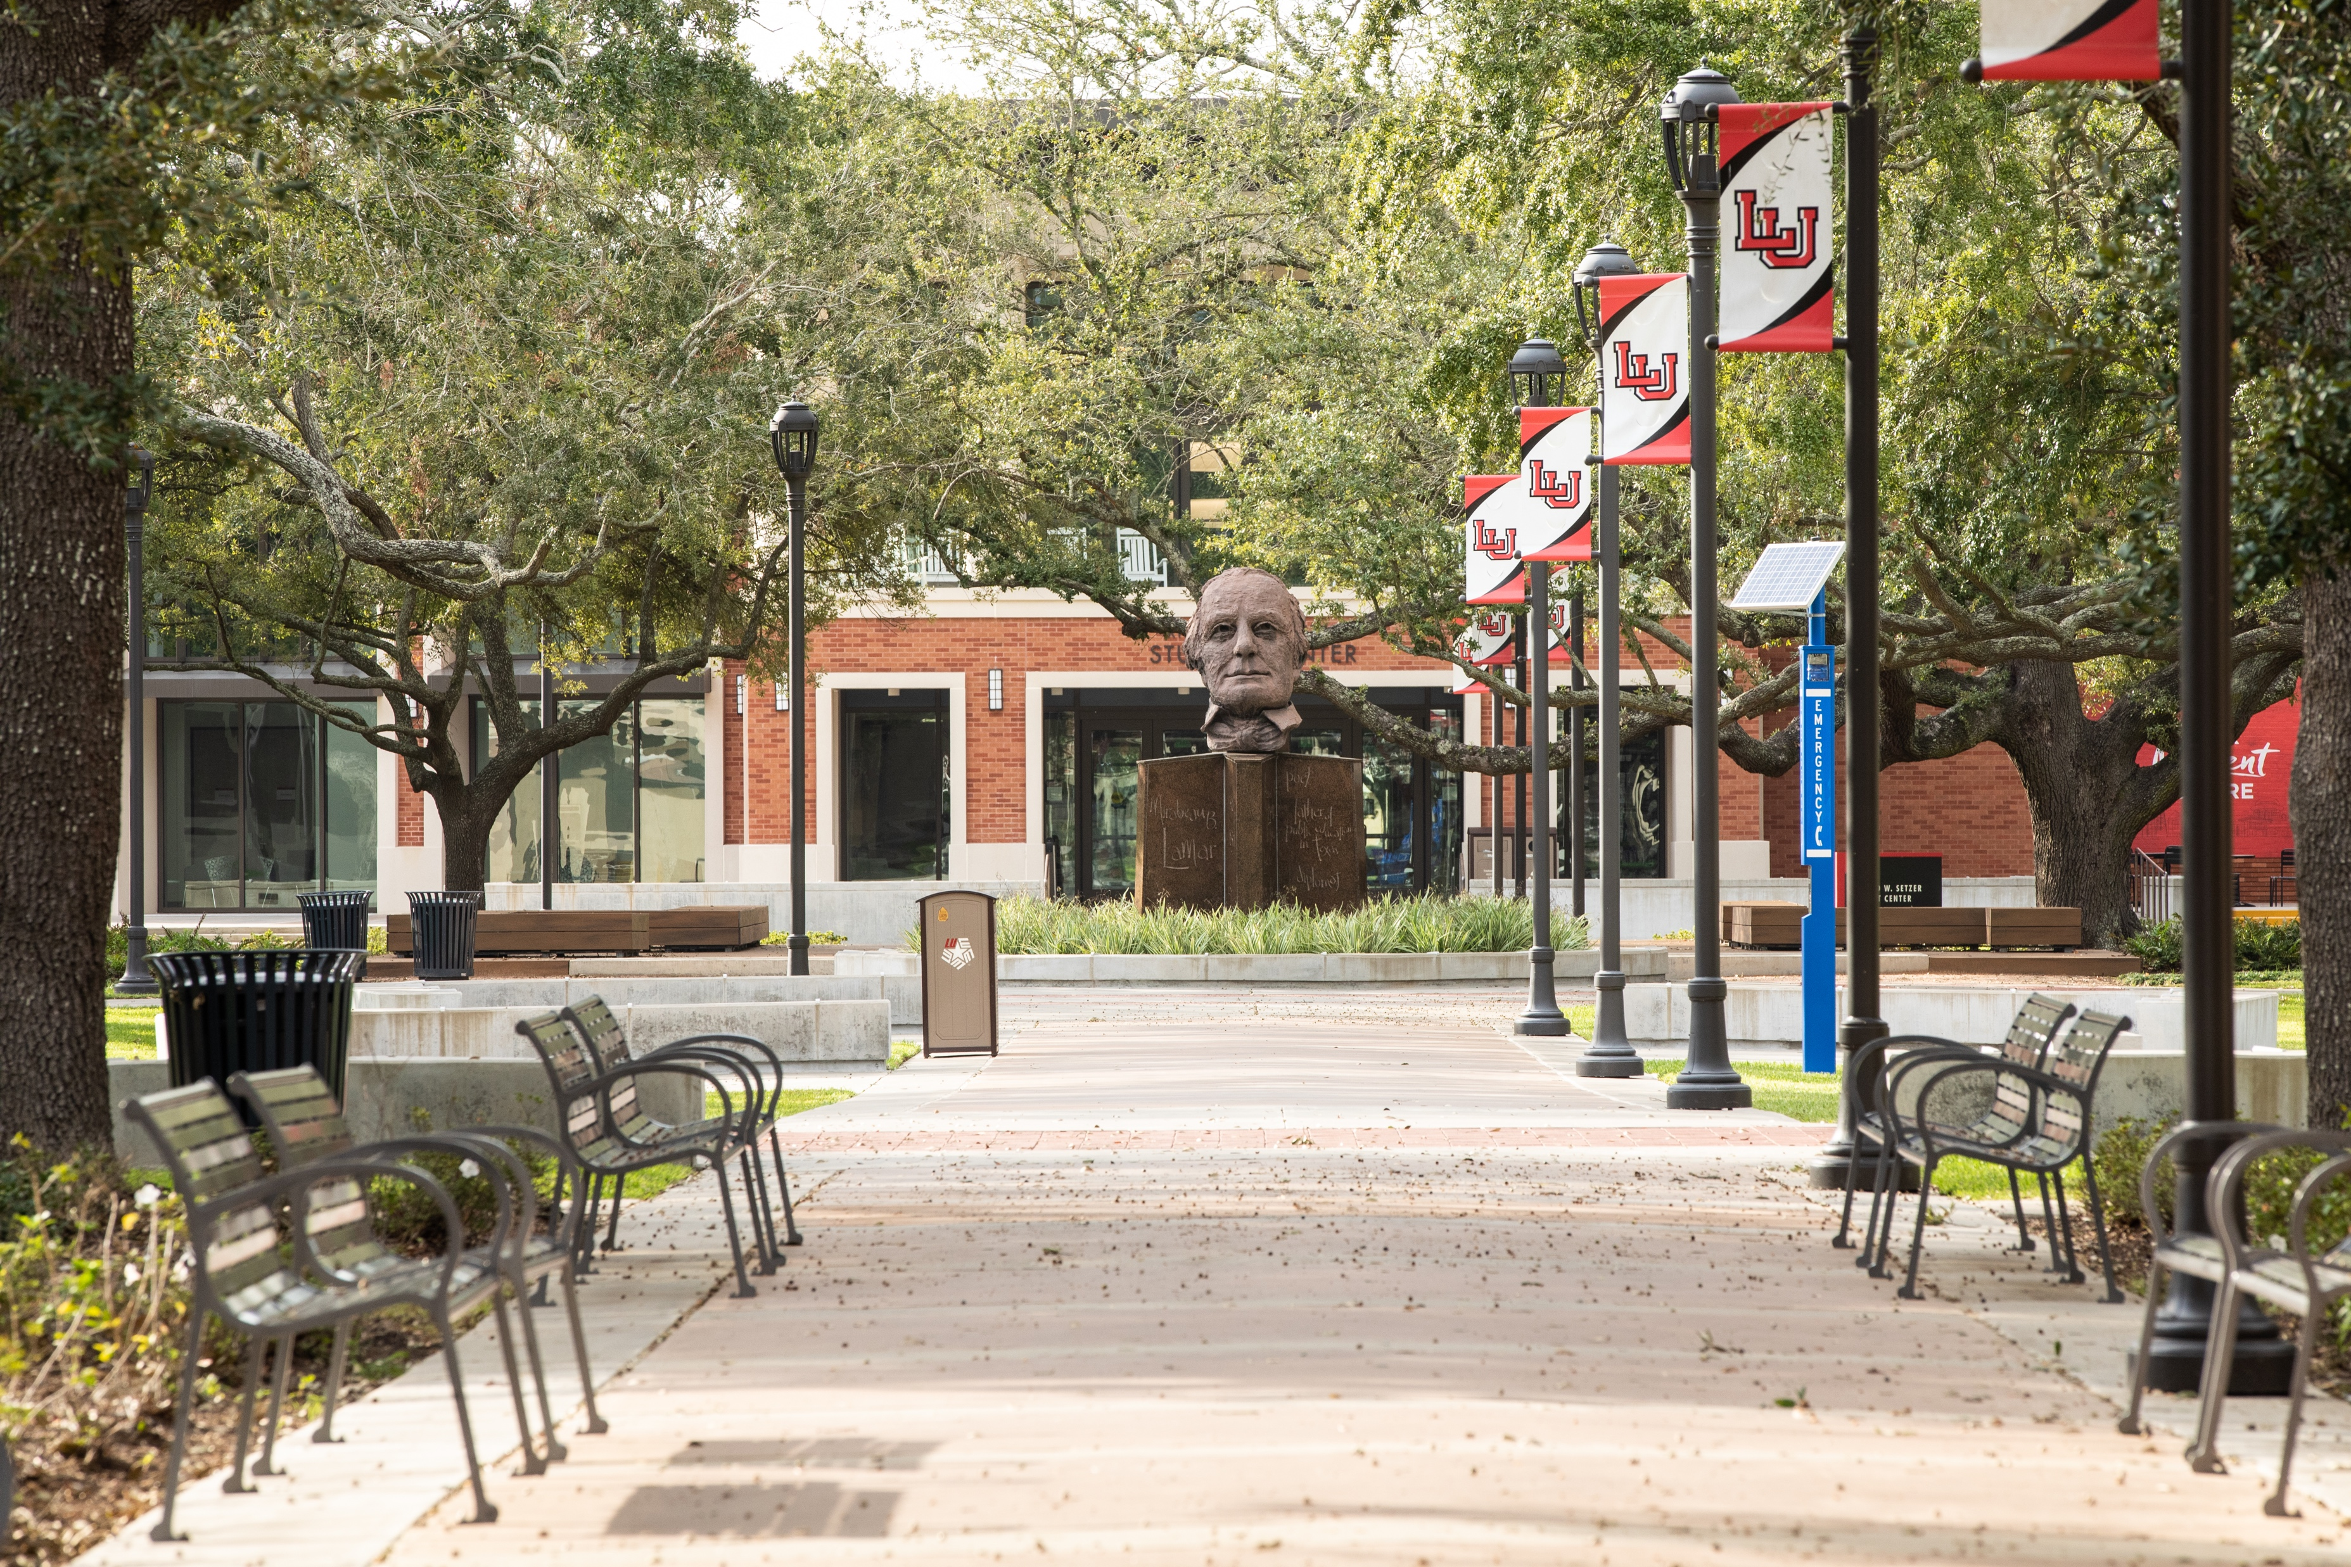

The Texas Academy Experience
HUGE OPPORTUNITY –
FINISH HIGH SCHOOL EARLY -
START COLLEGE EARLY!!
9TH-10TH-11TH
+What is the Texas Academy?
+When do I apply?
+How do I get admitted?
+What do I study?
+Where do I attend classes?
+What is in for me?
Notes:
Tilisa

Slide 3

The Texas Academy is…
“an accelerated program for gifted and talented high school students in Texas who desire rigorous academics, innovative research, and service leadership opportunities designed to enhance student learning and leadership in a variety of academic areas,
including Humanities, STEAM, and Liberal Arts.”
Notes:
Tilisa

Slide 4
What is our WHY?
We inspire students to transform their passion into their purpose through rigorous academics, innovative research, and service leadership.
INSPIRE. IMAGINE. INNOVATE. IMPACT.
Notes:
Tilisa

Slide 5

How do we do this?
We offer high-impact educational experiences by supporting significant learning environments that offer choice, ownership, and voice through authentic learning opportunities.
INSPIRE. IMAGINE. INNOVATE. IMPACT.
Notes:
Tilisa

Slide 6

Who our students become...
Successful high school graduates who get accepted into their choice of top-tier schools where they impact and inspire others through innovation and leadership.
Notes:
Tilisa

Slide 7

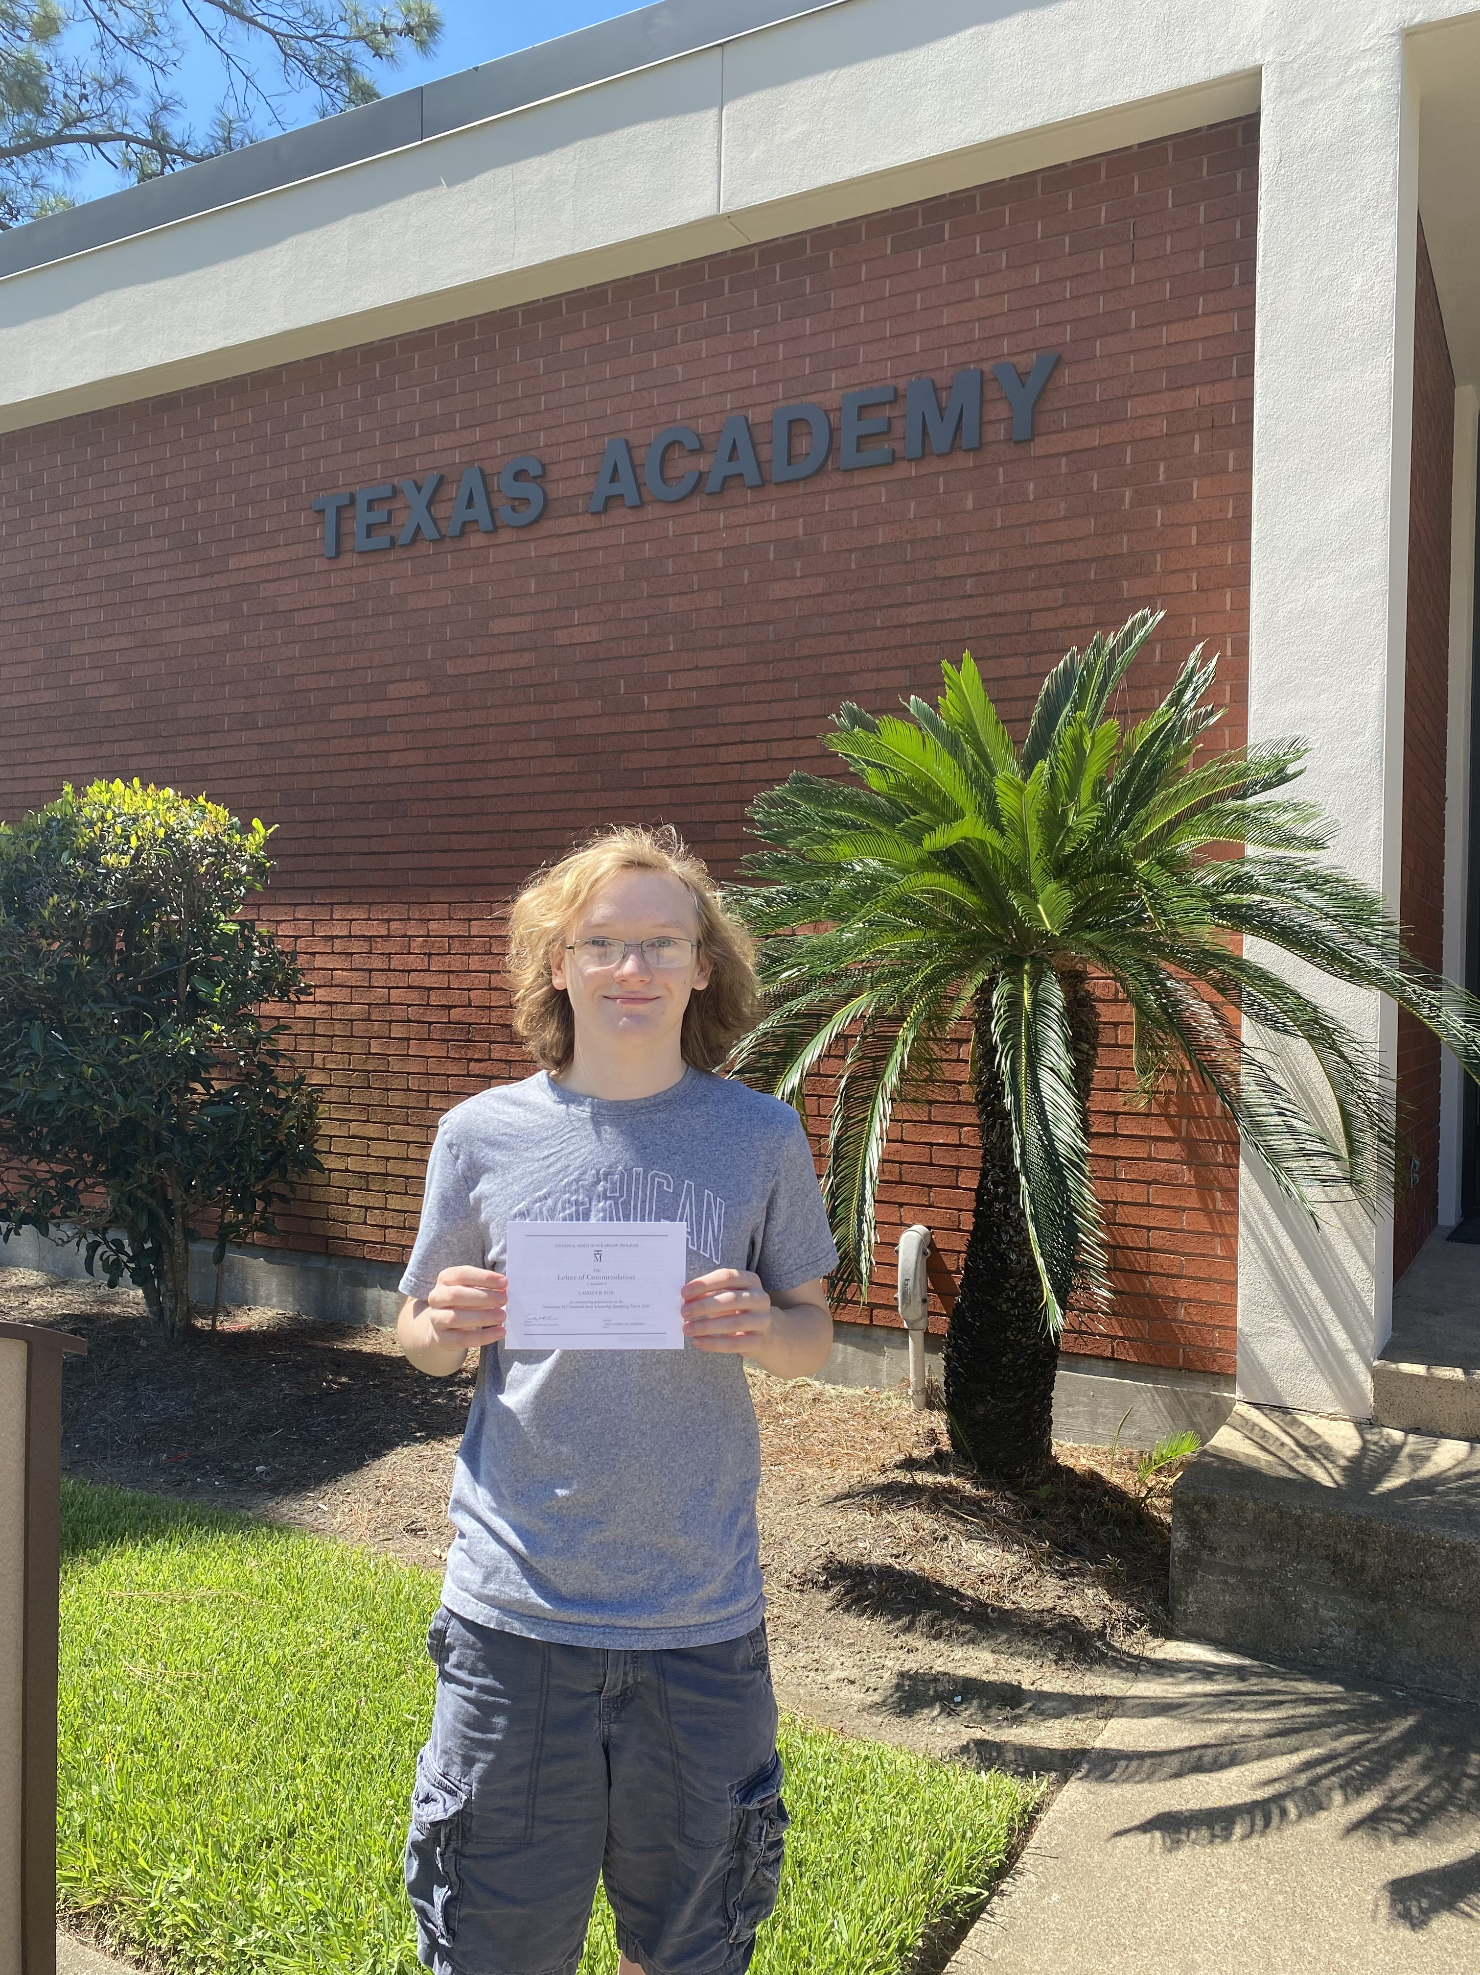
Snapshot of an Academy Student
ACT – take this early
Composite Score: 24/25 or higher (at least 22 on Math and English portions)
SAT – take this early
Composite Score: 1130
Math: 550 / 610
English/Writing: 580 / 680
GPA
3.8/top 10% of class
EOC-STAAR exams:
4000 + English III Level II; Algebra 2 Level II
INSPIRE. IMAGINE. INNOVATE. IMPACT.
Notes:
Tilisa

Slide 8

Distinguished Academic Tracks
Bachelor of Business Administration (AACSB accredited)
Engineering (ABET accredited)
Pre-Medicine / Pre-Dentistry
Pre-Nursing / Pre-Allied Health
Multi-Disciplinary
Education
Individualized Degree Plans
Notes:
Dann

Slide 9
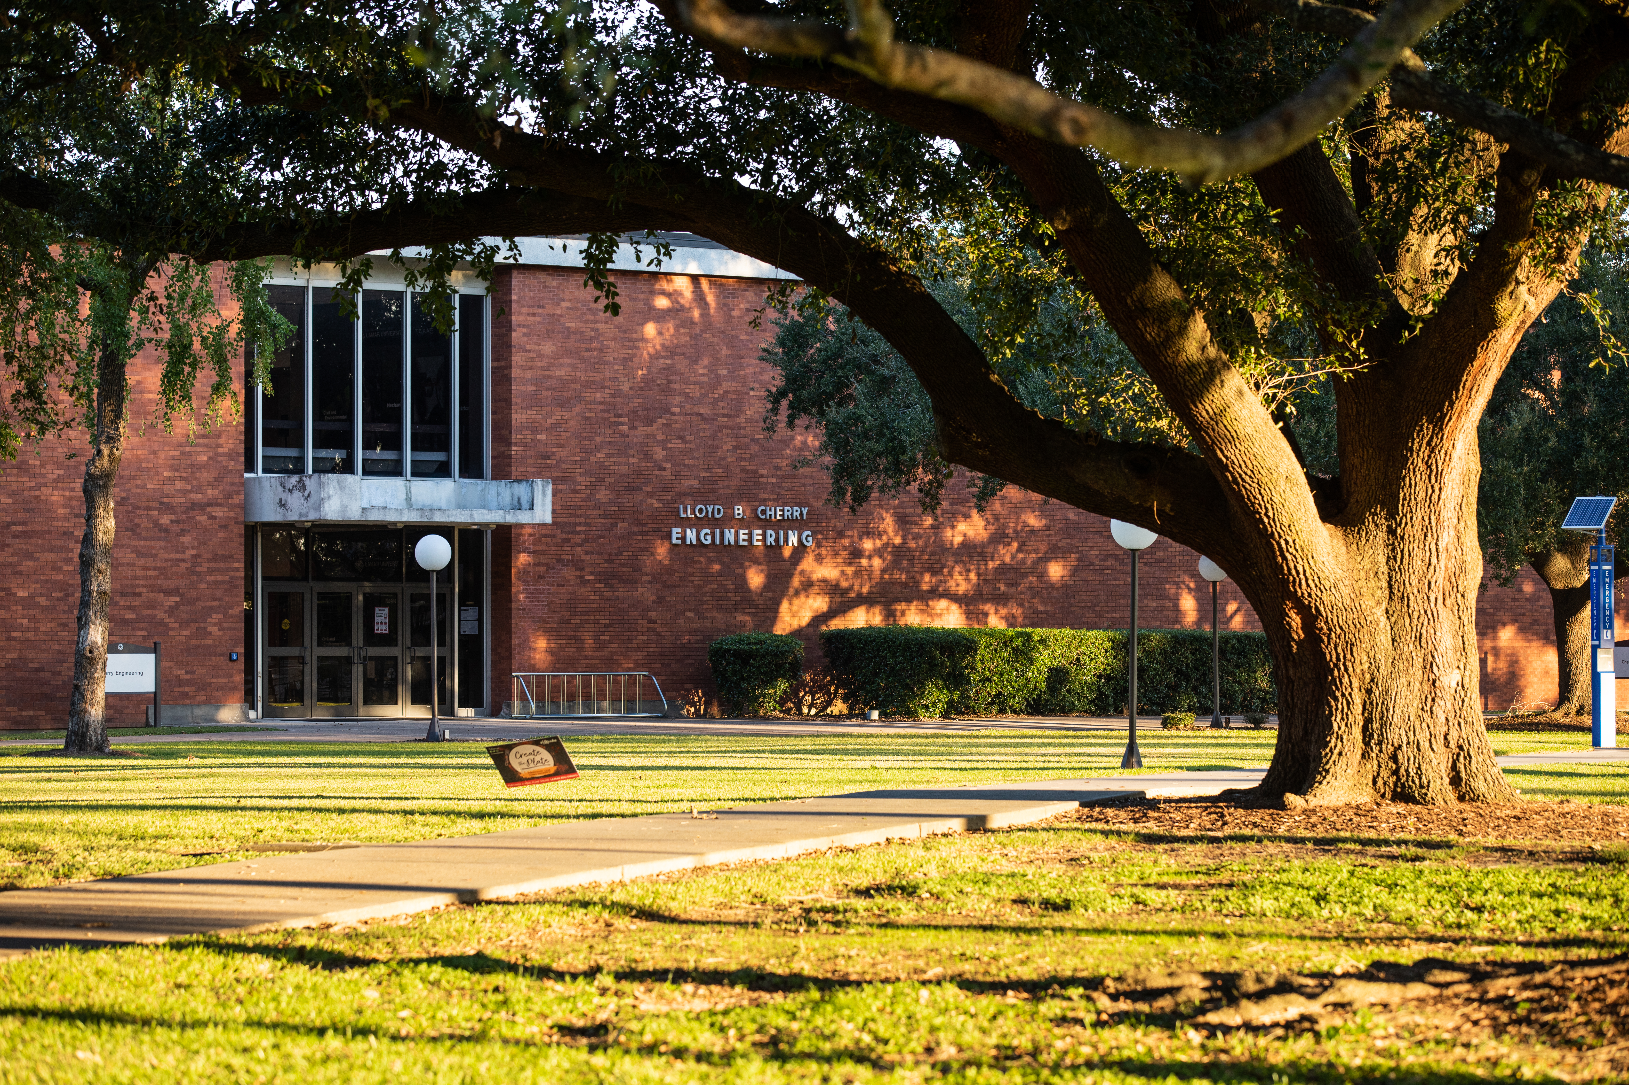
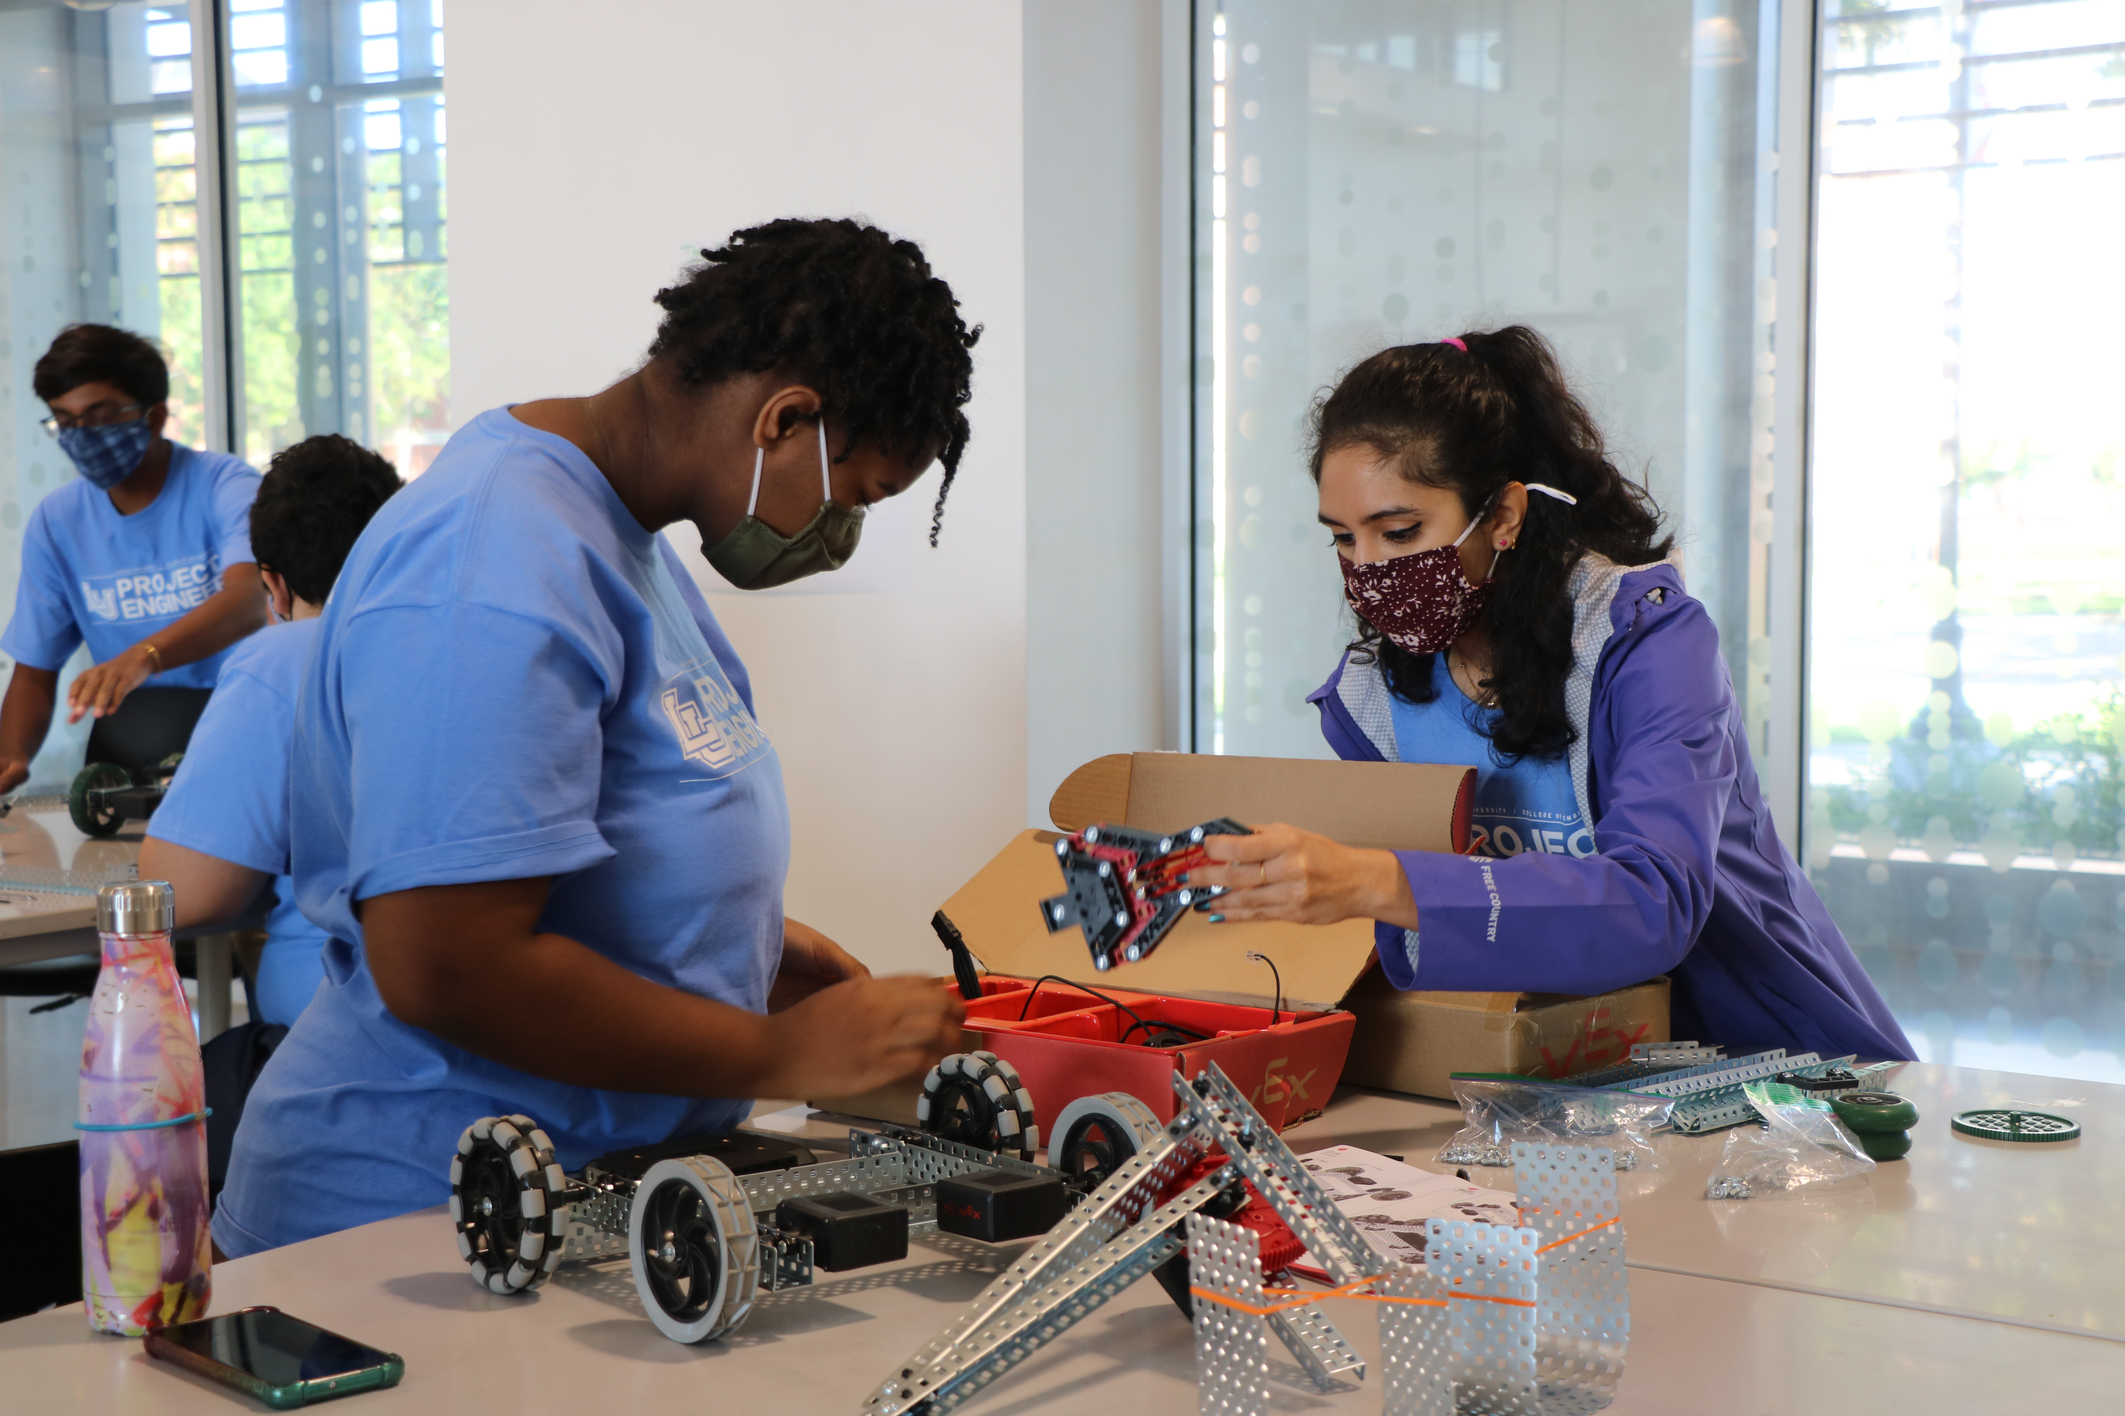

GET STARTED IN THE COLLEGE OF ENGINEERING EARLY…..
CHEVRON

Slide 10



Innovative Research
Research grant opportunities funded through O.U.R.
Faculty mentorships with experts in your area of study
Potentially publish your research in a journal
Notes:
Tilisa

Slide 11

Service Leadership
College readiness workshops
Campus service and community engagement opportunities
Community of like-minded, high-achieving learners
Informal Internships and shadowing experiences
Notes:
Tilisa

Slide 12
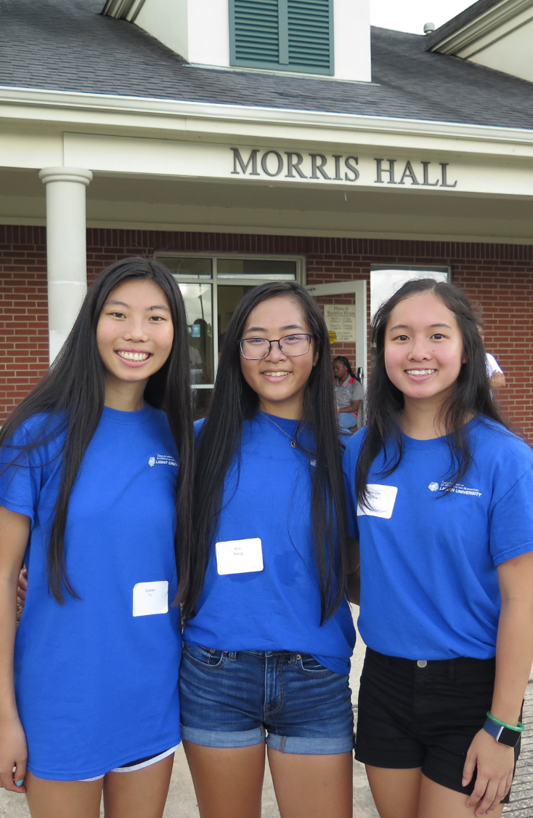
Residence Halls & Campus Living
Academy specific RA’s
Nightly curfew checks
On-site, overnight security officer & CCTV
Additional hallway security measures
Live at home within 30 miles
Per Semester:
Dorm Room fees: $3,136
Board fees: $1,504 to $1,806
INSPIRE. INTEGRATE. IMAGINE. INNOVATE. IMPACT.
Notes:
Vianna & Lance

Slide 13
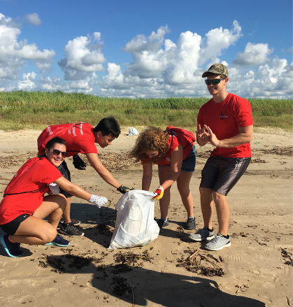

Student Engagement
Week of Welcome activities
LU Orientation/Texas Academy Orientation
Homecoming events –Fanfest, Tailgate, Game
Over 150 registered clubs and organizations
Student Council, Clubs, and Committees
AlumChats & Alumni Mentoring
Band and Choir
Intramural sports
INSPIRE. INTEGRATE. IMAGINE. INNOVATE.
Notes:
Panel

Slide 14



Student Opportunities
STEM/STEAM Club
Humanities & Culture Club
JSA Club
Go Red Club
Art Club
Social Club
Media Club
Community Engagement Committee
Safety and Security Committee
Parent Committees – Spring Fling
Events Committee
PEER MENTORS
INSPIRE. INTEGRATE. IMAGINE. INNOVATE. IMPACT.
Notes:
Panel

Slide 15

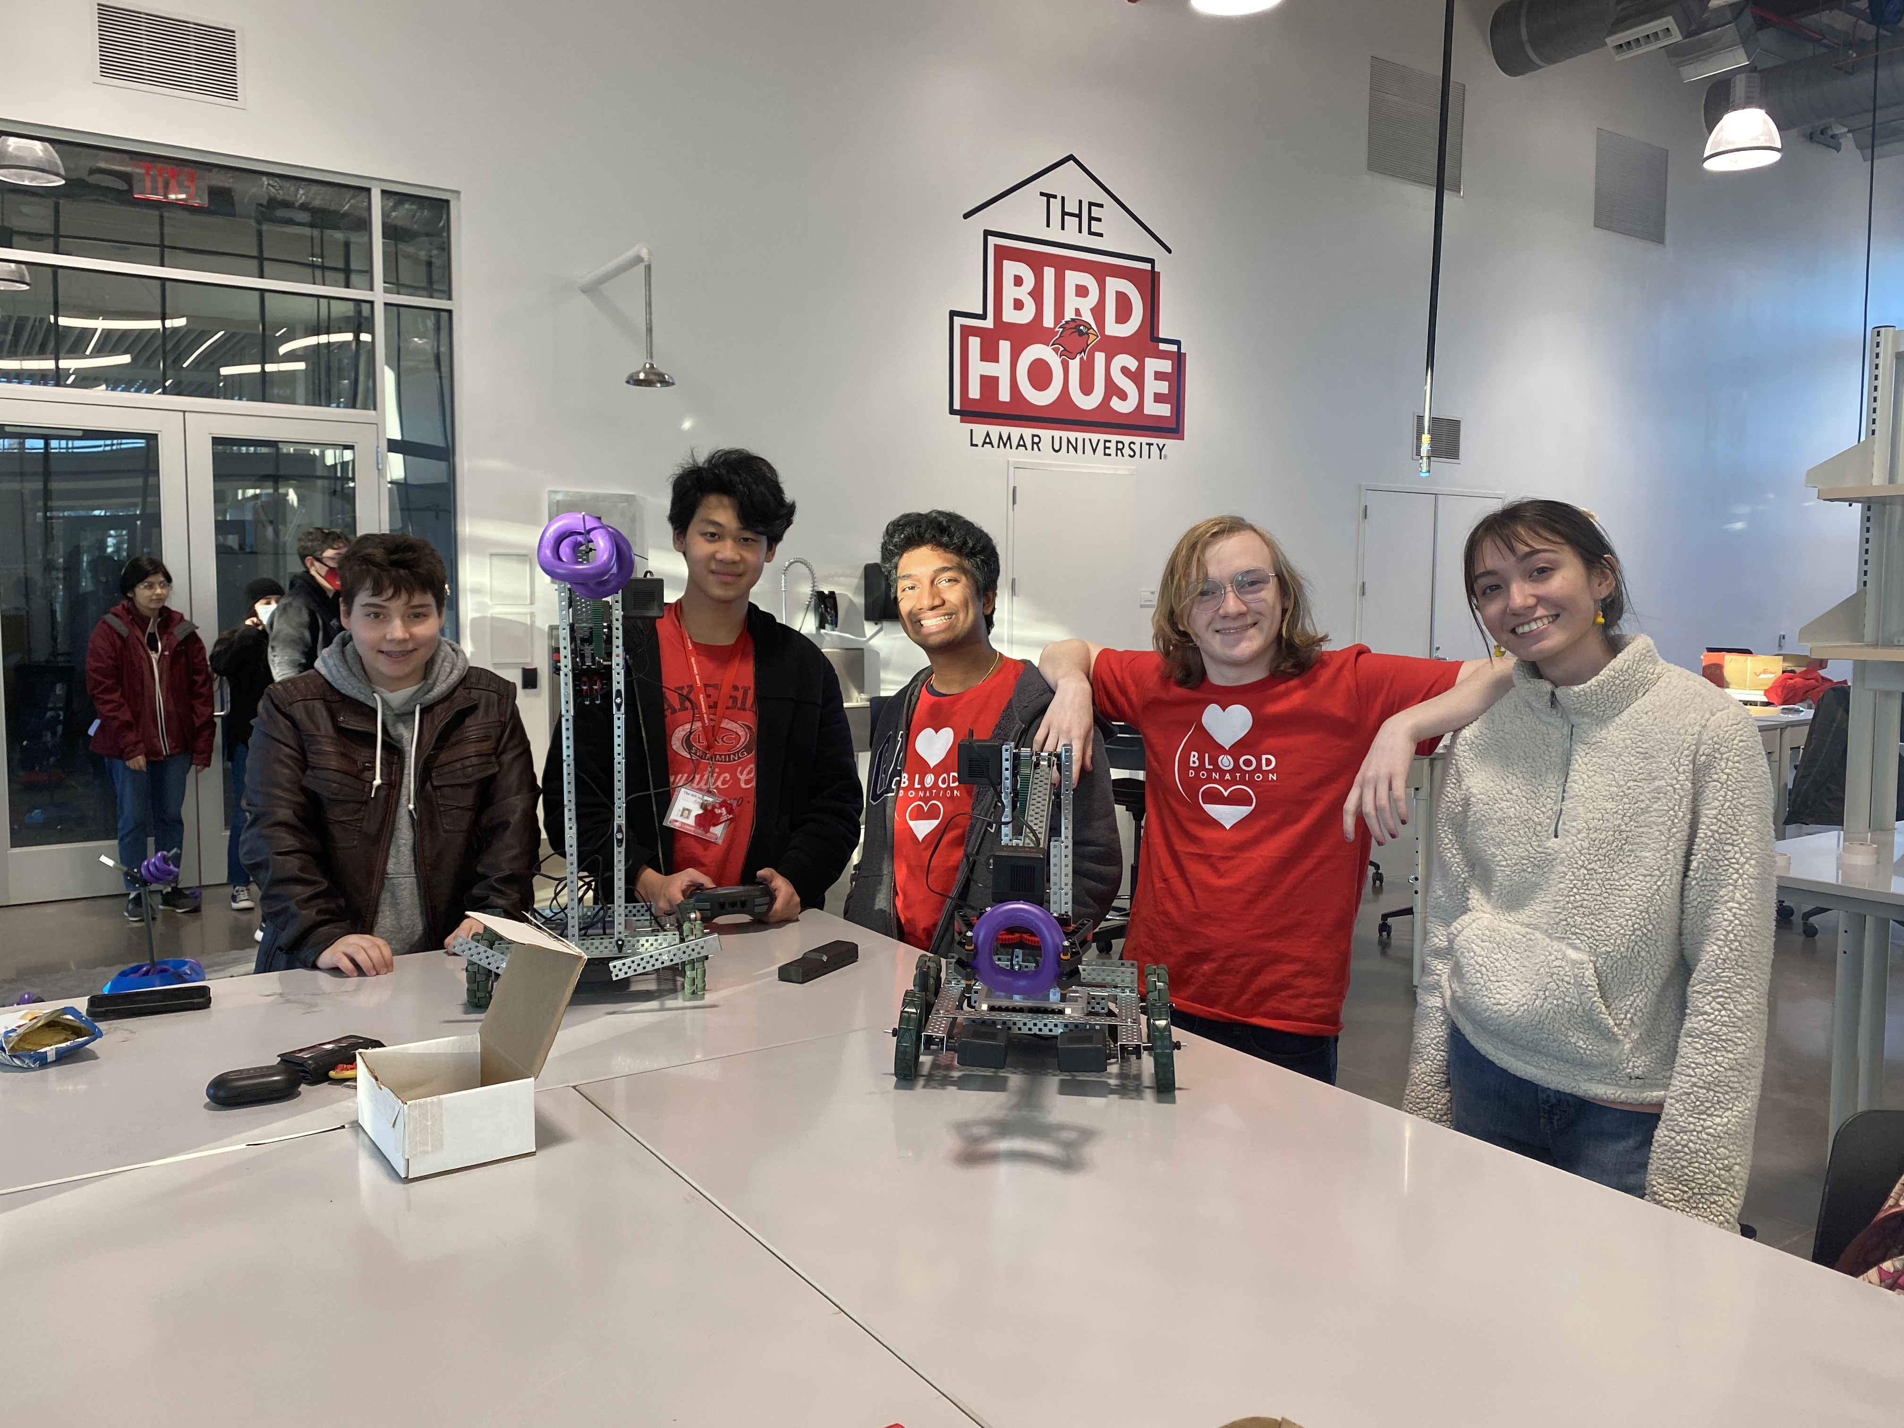

STEM CLUB partners with Robotic Cardinals

Slide 16

30-60 + hours of college credit toward your field of study
(core courses and electives)
4x4 distinguished track achievement plan
Core course completion – all public universities in TX
research and grant opportunities with faculty mentors – funding for research and support
student clubs and organizations
intramural sports, band
FREE tuition up to 15 hours per semester, fees paid for by LU
great opportunity for additional scholarship money and acceptance in the Honors College @ LU
Academy grads can apply for ALL FTIC and freshmen scholarships
Notes:
Tilisa

Slide 17

Visit our website: lamar.edu/texasacademy
Follow us @lu_talh
Follow us @LUTALH
Follow @Lamar University
Notes:
Tilisa

Slide 18



Pipeline to Reaud Honors College
Admissions
-TALH to Honors College pathway
-3.75 GPA or top 10% of high school
-LU/TALH transcripts
-Holistic review process
-Honors courses/leadership community
INSPIRE. IMAGINE. INNOVATE. IMPACT.
Notes:
Tilisa

Slide 19
Visit our website: lamar.edu/honorscollege
Follow us @reaudhonorscollege
Follow us @reaudhonorscollege
Follow us @Lamar University
Notes:
Tilisa

