Slide 1
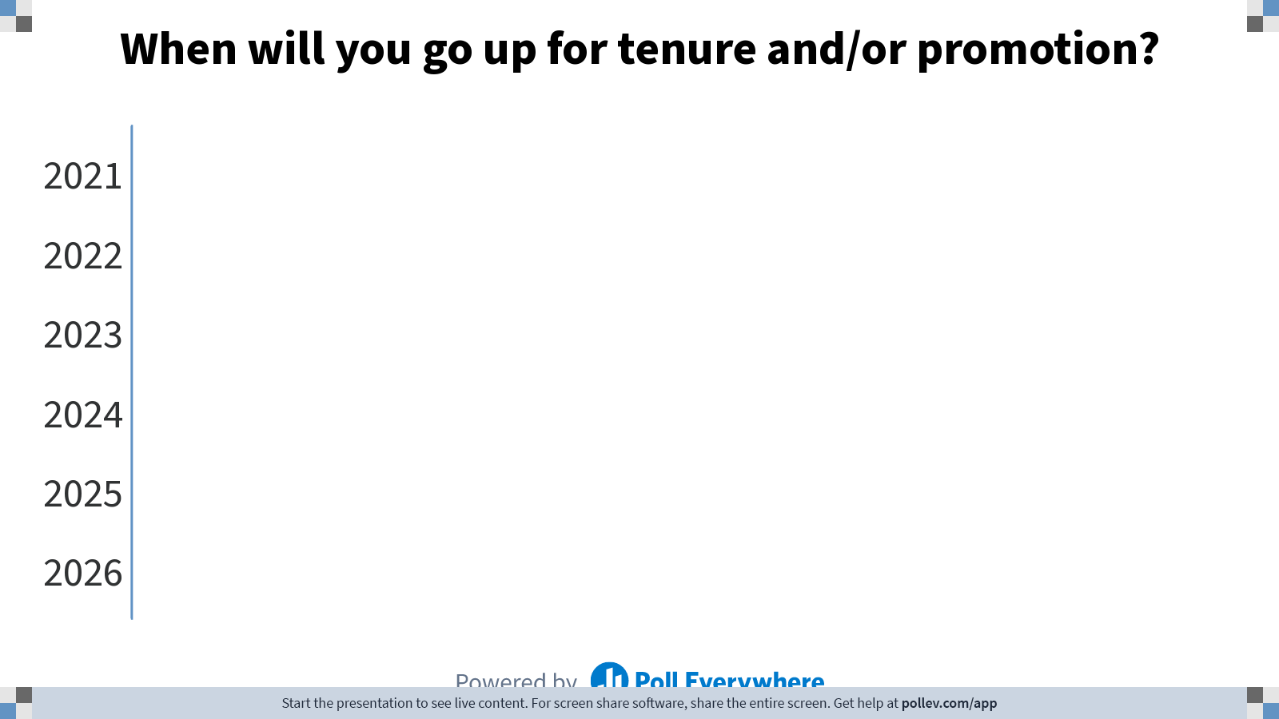
Notes:
Do not modify the notes in this section to avoid tampering with the Poll Everywhere activity.
More info at polleverywhere.com/support
When will you go up for tenure and/or promotion?
https://www.polleverywhere.com/ranking_polls/3Ra0VTJye5uCrZyDFjDSe

Slide 2

Navigating the Promotion
& Tenure Process
Provost’s Kickoff
Tilisa Thibodeaux
2021
Lamar University

Slide 3
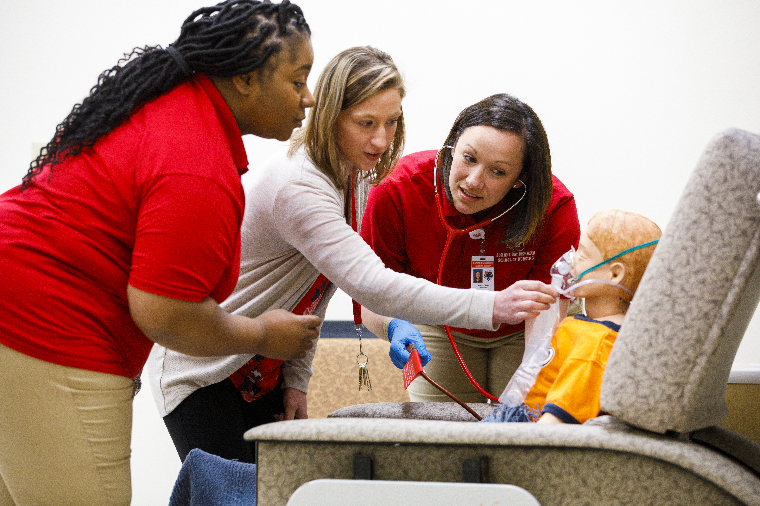
University Faculty Handbook Guidelines
Research the university faculty handbook guidelines and process ahead of time.
Faculty Handbook Guidelines
Policy: Procedures for Faculty Promotion
Chapter: II, Policies & Procedures
Section 15
Last Approved: January 2019
Begins on page 45

Slide 4
College or Department Guidelines
Research your college or department guidelines and the process ahead of time.

Slide 9
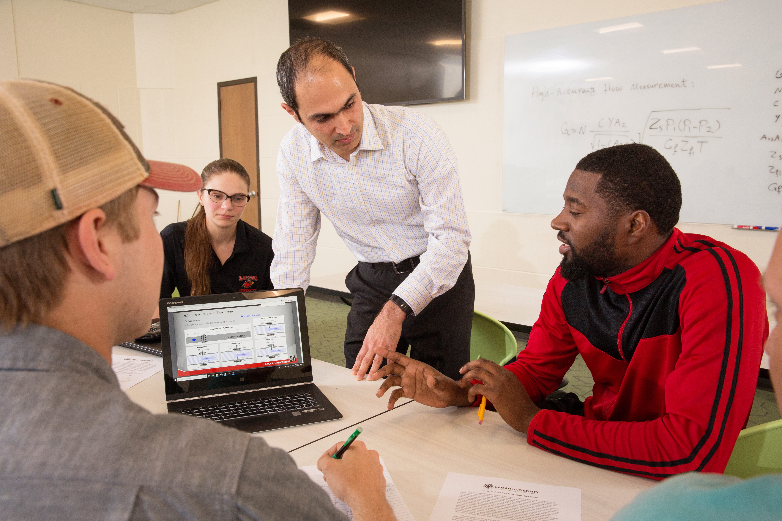
Tips for Success
Start collecting items right away.
Digitize all signed F2.08’s.
Digitize all signed reviews.
Collect letters of support.
Format your binder to use front and back pages, if possible.
Keep your CV updated; add to it as soon as anything posts or changes.
Share your research agenda; what do you stand for?
www.tilisathibodeaux.com

Slide 10
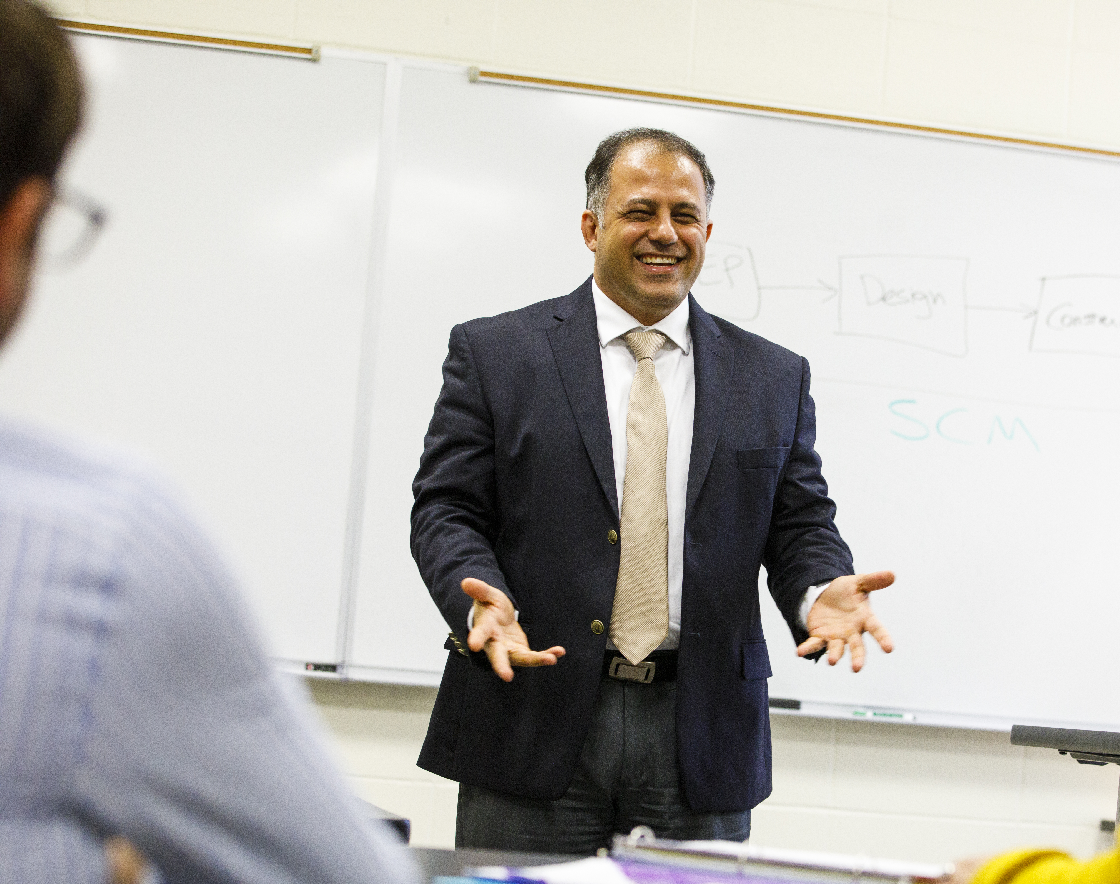
Tips for Success
Connect with your colleagues.
Articles – 1 in press, 1 in review,
1 in progress (1-1-1)
Tell your story; don’t leave important details out.
Be clear about your research agenda.
Title pages and comprehensive overviews are helpful for reviewers.
Scan and save a digital copy of everything, if you can.
CLEAR and Compelling

Slide 11
Questions?

